Slide 1
Group diversity
DAT096 2020: Jan 27
Anthony Norman and Becky Bergman
Division for Language and Communication
Department for Communication and Learning in Science
Notes:
BB 13-16
To do:
Post slides and choodle link on Canvas
Watch AN’s films and incorporate his questions

Slide 2

Great people don’t think alike
Notes:
Volvo ad

Slide 3
Diversity
Culture
Gender
Discipline
Class
Religion
Notes:
Culture vs culture (Holliday)
Picture from Nature + results (graph)
Wheelan vs Hofstede
https://www.scientificamerican.com/article/how-diversity-makes-us-smarter/

Slide 4
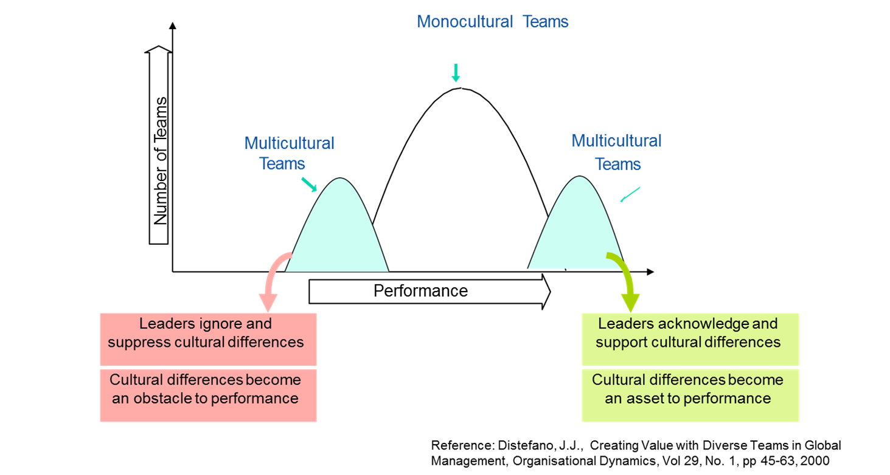
Cultural diversity
Better results in scientific publications in diverse teams
Freeman, R. B., & Huang, W. (2014). Strength in diversity:Nature, 513(7518), 305-306
Diversity makes us smarter
https://www.scientificamerican.com/article/how-diversity-makes-us-smarter/

Slide 5
Cultures don’t meet, people do
Hoffman and Verdooren, 2018
https://www.youtube.com/watch?v=BjrmS9qsQCk (Tedtalk, Verdooren)

Slide 6
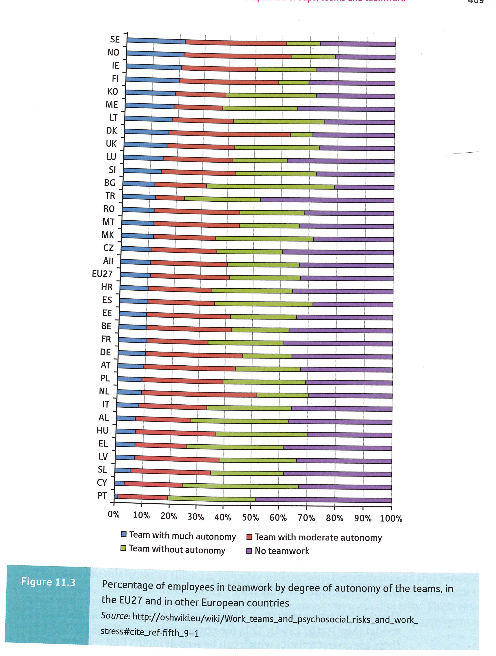
Group work in companies in Sweden
Sweden:
-a lot of team work in companies
-a lot of autonomy expected in team work
Notes:
BB
EU abbreviations:
IE: Ireland
KO. Kosovo?
ME. Montenegro
LT: Lithuania
LU: Luxembourg
SI: Slovenia
TR: Turkey
Note that countries have different definitions of what group work is e.g. in Bulgaria team work is if you work in the same department

Slide 7
http://oshwiki.eu/wiki/Work_teams_and_psychosocial_risks_and_work_stress#cite_ref-fifth_9-1

Slide 8


Differences of opinion?

Slide 9
Example Master’s group
B:
Missing from a number of meetings and difficult to contact
A / E:
Works hard
Puts in a lot of hours
Important that it is a successful project
D:
Takes charge of report writing and documentation for the group
C:
Works alone
Quiet
What should this student do? What should the team do?
Notes:
Hand out with case study on
10 mins
Stereotyping
-who’s the Swede? The Indian? The Chinese student? The Southern European student?
-How to solve this situation?

Slide 10
Stories from last year….

Slide 11
Activity 1: same, same but different

Slide 12

Same same but different
People in boxes: YouTube
Notes:
We tend to gravitate towards our own type
Hofstede

Slide 13
Which boxes…..
Not allowed!
-program!
-gender!
-physical attributes e.g. eye colour
Be prepared to report back!
Discuss what you have in common as a group…..
  We are all……. / Most of us are……
  Find 3 key similarities
Discuss what the differences are……
  Find 3 key differences
How might that affect your group work?
Tips:
-Bachelor studies
-Work experience
-Programming knowledge
-Hobbies
-Food and drink choices

Slide 14
Results of survey

Slide 15
Results of survey: Top 5 in being a good group member
Notes:
Last year top 5: show respect, meetings on time, listens actively, shows politeness, attends all meetings
20 /31 students responded

Slide 16

Coming to meetings on time? PUNCTUALITY
How can you show respect?
Well prepared for meetings
Listen actively?
Language choice?
Contribute actively?
Coming to meetings? ACTIVE / INVOLVED
% that were very important or important
Notes:
Interesting words but what do they mean?
Even in cases where there is a group contract, there are different interpretations of what these words mean.
Look at examples from the survey and whether people thought these were very important / important.
Does respect mean coming on time? Being prepared? Speaking in English? What does it mean to listen actively? Contribute actively?
20 min discussion
This discussion will be used in criteria discussion later
BREAK

Slide 17
SCRUM: Respect
We show respect for people, their experience and their personal background.
We respect diversity (it makes us stronger).
We respect different opinions (we might learn from it).
We show respect for our sponsors by not building features that nobody will use.
We show respect by not wasting money on things that are not valuable or might never being implemented or used.
We show respect for users by fixing their problems.
We respect the Scrum framework.
We respect our wider environment by not behaving as an isolated island in the world.
We respect each other’s skills, expertise and insights.
We respect the accountabilities of the Scrum roles.
https://guntherverheyen.com/2013/05/03/theres-value-in-the-scrum-values/

Slide 18
Result of survey: Top 5 in being a good group
Notes:
Some of the categories need ”unpacking”. How is conflict dealt with directly? The first one here (members safe) comes from New York Times article on Google group dynamics
Last year: psych safe, clear documentation, focus on work, make decisions together, deal with conflict directly
We’ll come back to conflict next week
1 student comment:
A good group finishes the job, even if everyone hates each other in the end.
A good group member does not give up unless exempted from fulfilling their contractual obligations for causes beyond their control.
A good group does not appoint one member as a scapegoat and then proceed to illogically nitpick negatively said member's actions and contributions.
A good group should be able to discuss and engage on members' personal level, but work is the main focus and should take front seat whenever needed.
In a good group, everybody contributes to the end result.
In a good group, people put down real effort to the limit and extent of that person's abilities as not to destroy the ambition set by others.
In a good group, a member must be able to accept constructive negative feedback, and must be able to accept that one's work might not contribute to the end product, possibly at all. The effort is still counted as a job well done, provided it was done to the extent of the individual's abilities.
A good group member contributes to its best abilities to the actual product and does not rely on fetching refreshments as their foremost property to the team.
A good group member is loyal to the project, and does not accept paid for trips to holiday resorts during the project period because this leaves said member's work to be done by others.
A good group member is honest, even if it exposes her/him as being lazy and unproductive.
The absolute deal breaker on being a good or bad group member, is whether she/he tried her/his best, and not whether the end result was good or bad.

Slide 19
Activity 2: positioning

Slide 20
Choosing position
Position yourself in the classroom for the following statements. All the statements refer to groupwork. Be prepared to justify why you are standing where you are!

Slide 21
Language skills
If everyone has a good level of English, there are few communication difficulties

Slide 22
Disagreements in groups
You should tell the rest of the group when you don’t agree with them

Slide 23
Disagreement with supervisor
You should tell the supervisor when you don’t agree with them

Slide 24
Being honest
You should tell other people in the group when there is a problem

Slide 25
Conflict
You should avoid conflict in groups

Slide 26
Leadership
A good group has a leader who assigns tasks to the group members

Slide 27
Contribution
A student who doesn’t contribute should not be included in the final report

Slide 28
Activity 3: empathy

Slide 29
Example Master’s group
B:
Missing from a number of meetings and difficult to contact
A / E:
Works hard
Puts in a lot of hours
Important that it is a successful project
D:
Takes charge of report writing and documentation for the group
C:
Works alone
Quiet
Choose 1 student in this group: try out the 360 degree model on them.
What are their motivations / frustrations in this group?
Notes:
10 mins
Stereotyping
-who’s the Swede? The Indian? The Chinese student? The Southern European student?
-How to solve this situation?

Slide 30
360 degree view
Current situation:
What success looks like in this situation:
Around
Within
Within
Between
Behind
Behind
Others
Given the situation you have mapped above, what does this suggest your next steps should be to enable success:

Slide 31
Look TO OTHERS
Who are the KEY STAKEHOLDERS and what is their potential role in this situation?
E.g. Supervisors, examiners, other student groups, companies
What influence could the SURROUNDING SYSTEMS and GENERAL ENVIRONMENT have on you?
E.g. practicalities like meeting times, workspace available, schedules, deadlines
Look AROUND
What PRESSURES and MOTIVATIONS could be influencing you?
E.g. other courses, jobs, re exams
Motivation level for course?
Look BEHIND
What are the VALUES that could be driving you? What are the likely GOALS and EXPECTATIONS you have?
E.g. ambition level
Look WITHIN
What role could your CULTURES be playing?
E.g. different perceptions of time, power, team work
Look BETWEEN
Based on Kate Berardo ”Tool: A 360 Degree View on Cultural Dilemmas” in Building Cultural Competence 2012

Slide 32
Example Master’s group
B:
Missing from a number of meetings and difficult to contact
A / E:
Works hard
Puts in a lot of hours
Important that it is a successful project
D:
Takes charge of report writing and documentation for the group
C:
Works alone
Quiet
What should this student do? What should the team do?
Notes:
Hand out with case study on
10 mins
Stereotyping
-who’s the Swede? The Indian? The Chinese student? The Southern European student?
-How to solve this situation?

Slide 33
Development of intercultural sensitivity
Denial
Defense
Minimization
Acceptance
Adaptation
Integration
Ethnocentric stages
Ethnorelative stages
Bennett 1986
Notes:
Denial: One’s own world view is unchallenged as central to all reality ”my way is the normal way”
Defense: Difference is recognised and seen as threatening and results in negative stereotyping or regarding other cultures as inferior
Minimization: cultural difference trivialised; cultural similarity emphasised
Acceptance: cultural diffference recognised and accepted and respected
Adaptation: empathy – one construes events as if one were the other person ”walk the walk”
Integration: person who experiences difference as an essential and joyful aspect of all life

Slide 34
Extra support at Chalmers
writing.chalmers.se
  For Chalmers Writing Centre
  For writing tips at Master’s level
Language and communication courses
  https://www.chalmers.se/en/departments/CLS/education/undergraduate/language/Pages/default.aspx
Mail Becky at becky@chalmers.se for more information

Slide 35
Deliverables connected to group dynamics in the course

Slide 36
Learning outcomes
Course goals:
3. Contribute, in several team roles, to a multi-person project where an industrylike project model is used. This includes planning, follow-up and trade offs under resource constraints.
4. Reflect on the group process in an international team.
This will be achieved through:
  Reflecting on practices of successful group work
  Formulating and following a group agreement
  Showing awareness of one’s own strengths and weaknesses
  Critically assessing the individual contribution to the group project
Notes:
LOs for seminar and workshops
BB

Slide 37
Deliverables connected to group diversity
Event | Time | Learning outcome
Group contract | 10 Feb | Formulating and following a group agreement
Mid term team assessment | 5 Mar | Critically assessing the individual contribution to the group project Showing awareness of one’s own strengths and weaknesses
Team reflection meeting | 9 / 10 Mar | Reflecting on practices of successful group work
Team reflection report | Exam week | Reflecting on practices of successful group work
Final team assessment | Exam week | Critically assessing the individual contribution to the group project Showing awareness of one’s own strengths and weaknesses
Notes:
BB

Slide 38
Group contract
Suggested template on Canvas:
Meetings
Division and execution of work
Team decisions
Scrum values
Handling of documents and files
Communication outside meetings
Consequences if team member breaks contract
Ambition
Notes:
BB

Slide 39
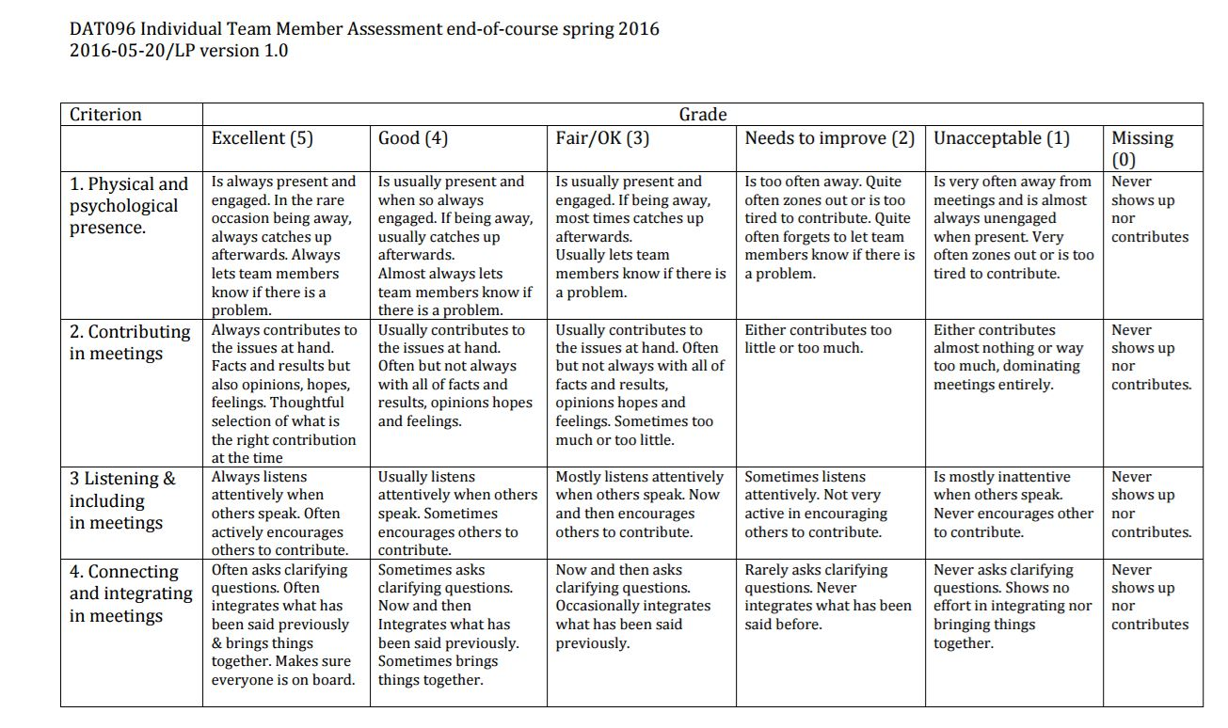
Mid term team assessment
Notes:
To be used in mid term assessment
Will be used as part of final assessment
BB

Slide 40
Team reflection meeting (with Becky)
Reflection on results of team assessment
A possibility to rethink / adjust group contract / set up in group
Will book times via a Choodle (link on Canvas):
https://choodle.portal.chalmers.se/g7874JxXrhFqXtfi
45 minute meeting per group

Slide 41
Differences of opinion?

Slide 42
Back to the films / group work model
In your project groups:
The preparation you did (2 videos; 1 text) focused primarily on introducing Wheelen’s group development model:
How did you understand the model? (Discuss the model in your group, and see if you think about it in the same way)
How useful is the model? Which parts of the model are useful?
Are there any implications for your group contract? (i.e. does the model suggest certain ‘good’ ways of working? Ways to drive development?)
Notes:
I think keeping it to a simple summary/discussion of what they learnt re. the model, and then just focusing on what does it mean for their groups and work is enough. I had more, then got rid of it.
If you want to come back to Wheelen, I’d say go back to her statement from the video about attributing behavior (in this case dispositional attribution … explaining behavior in others by making negative assumptions about that person … e.g. they come late because they’re lazy). The French vs. Swedish managers case could work (didn’t do in session 1), or any other similar type activity which gets them to explore that idea of interpreting behavior, but if doing e.g. the quiet student scenario that would work better and could be linked to this.

Slide 43
References (Intercultural communication)
Downey, Gary Lee, et al. (2006) "The globally competent engineer: Working effectively with people who define problems differently." Journal of Engineering Education 95.2 107-122.
Duhigg, C. (2016) What Google learned from its quest to build the perfect team” The New York Times Magazine http://www.nytimes.com/2016/02/28/magazine/what-google-learned-from-its-quest-to-build-the-perfect-team.html?_r=0 Accessed 10 Oct 2016
Hofstede, G., Hofstede, G. J., & Minkov, M. (2010). Cultures and organizations: Software of the mind (Vol. 3). London: McGraw-Hill.
Geert Hofstede https://geert-hofstede.com/cultural-dimensions.html
Holliday, A., Hyde, M., & Kullman, J. (2010). Intercultural communication: An advanced resource book for students. Routledge.

