Slide 1
Notes:
SLIDE 1
Opening slide.

Slide 2
FPGA-based QPU interface unit for
fast qubit control and readout
Christian Križan
Research engineer, QTL
krizan@chalmers.se
Notes:
SLIDE 2
General welcome slide. Congratulations for selecting the first DAT096 project
on FPGA-QPU interfaces. Your product owner would be myself, Christian.
Currently employed as a research engineer at the Quantum Technology Laboratory,
MC2 (Chalmers).

Slide 3
What is it for?
Notes:
SLIDE 3
What is it for?
You have been tasked with constructing a QPU interface device, described in
its entirety as per FPGA. The Project introduction document, currently on
Canvas, introduces this project in further detail. This presentation will
focus on introducing technical aspects.

Slide 4
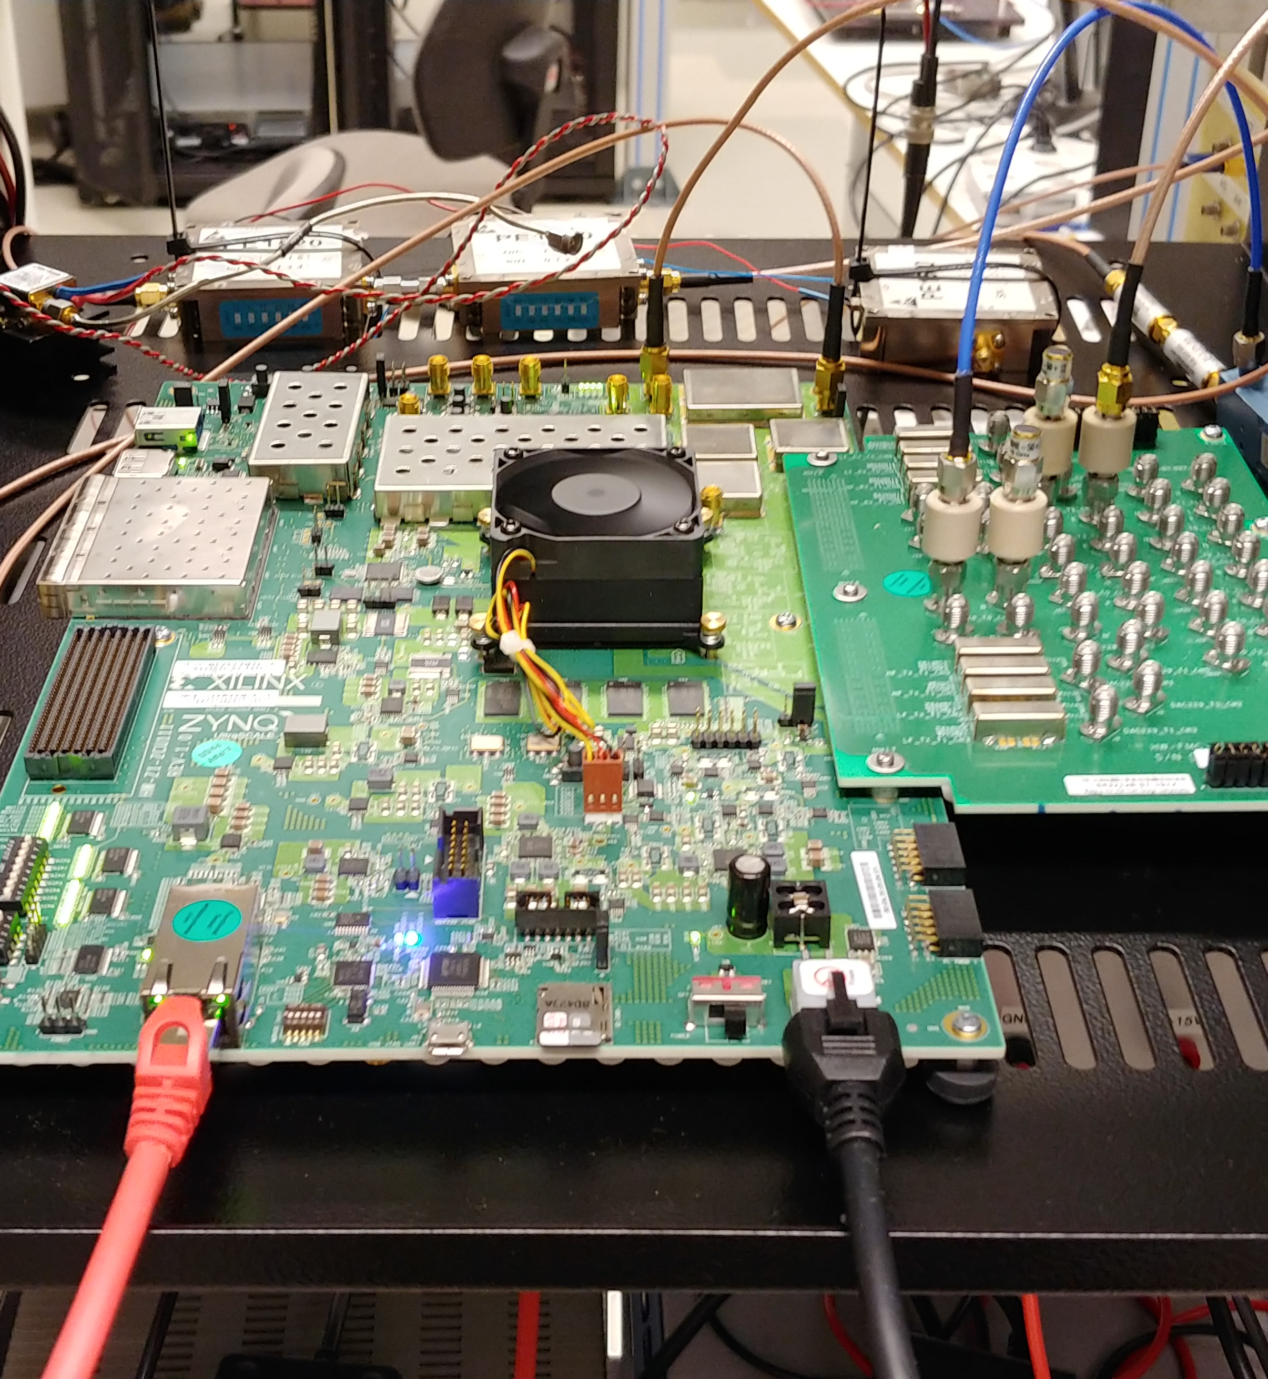
What is it for?
Qubit control
Qubit readout
Signal processing (to some extent)
Notes:
SLIDE 4
Cont. What is it for
The idea of this device it to act as the interface to a QPU. An operator
will specify some experiment, stream data to your device, which will then
control and readout the state of qubits.
Qubits are the fundamental processing 'unit' of a quantum processor. The
logical state of a qubit is much more complex than that of the classical
bit, ie. more complex than 0 and 1. These two logical states in fact comprise
a subset of the qubit logical space, often illustrated as a sphere with 0 and
1 on its two poles.
A typical qubit state is represented by a vector, drawn from the origin of the
sphere (its center) to its surface. But, depending on a broad set of factors,
the vector may point within the sphere itself as well.
I have outlined more introductory theory to the qubit in my master's thesis,
which is currently available on Canvas and in the Chalmers ODR.
The QPU is an analogue device. An RF pulse enters, gets modified, and leaves.
The resulting waveform contains the result of the quantum computation.
Often simply represented in a so-called IQ-diagram. This latter term, ie.
IQ-representation, is very relevant to the EESD engineer and appears
practically everywhere in DSP engineering.
The qubit signal is very weak at the QPU core, -135 dBm. So typically, there
are a lot of sources of noise etc. that the operator does not want sent back
to the host PC. This will be further outlined in the downconversion slides,
as this is the main purpose of the skip / store block (waveform windowing).
Apart from the so-called IQ-conversion stages, this comprises the simple DSP
work expected in your project. The major hurdle of this project will
highly likely be dataflow handling.

Slide 5
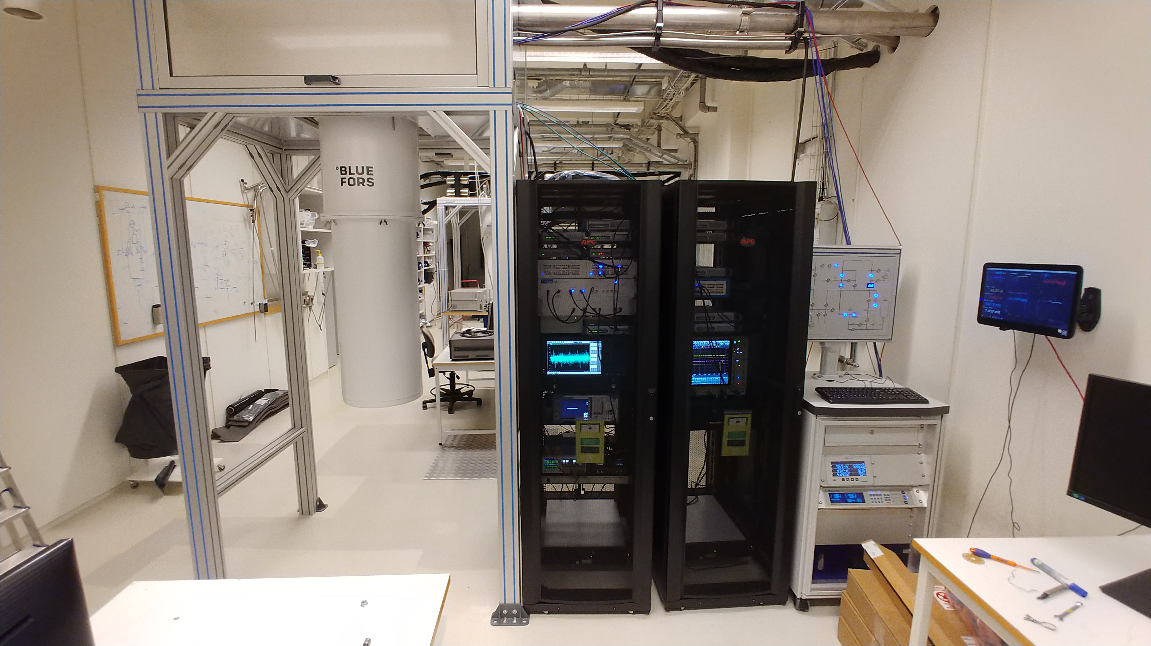
You’ll run it on one of these
Notes:
SLIDE 5
Illustrated: a quantum processor.
Quantum processors are third-level packaging systems. Components typically
consist of microwave equipment put in racks (black). The rest (white) is
a refrigerator, a helium-3 dilution cryostat capable of holding the QPU
core at 7 mK. The core holder is about the size of an egg (the chip is
of course much smaller), and resides inside a set of cylinders, themselves
residing inside the white cylinder on the left ("the vacuum can").
A lot of smaller components are put inside the refridgeration unit itself.
Microwave TWPA and HEMT amplifiers, isolators, cryogenic switches etc.
The illustrated QPU is the one I myself do most of my work on, it does not
use a user-configurable FPGA as its interface. Thus, your final testing will
be performed on another QPU, standing further back in this image.
There are currently four operational QPUs at QTL, Chalmers. We plan on
acquiring many more.

Slide 6
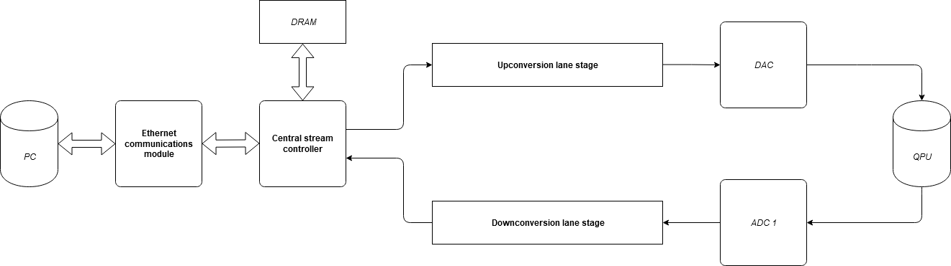
The very big picture
Notes:
SLIDE 6
The very big picture.
Your device comprises four major components: an Ethernet interface to a host
PC, a central stream controller, an upconversion stage, and finally a
downconversion stage.
The Ethernet module will receive / send packets to / from the host PC.
The upconversion lane will convert the payload contained within said packets
to appropriate microwave frequencies used for communicating with the qubit.
The downconversion lane will convert the output result from the QPU core
into host-PC-readable data.
Finally, the central stream controller will tie everything together in this
system.
Do note that the upconversion lane box contains within it a summation unit
("Add N") which allows for some nifty DSP tricks. It combines user-selected
DAC channels element-by-element into some data output.
All of these modules have been designed with the Nexys 4 DDR board in mind.
The final device however, will be the Xilinx Zync Ultrascale+ RFSoC.

Slide 7
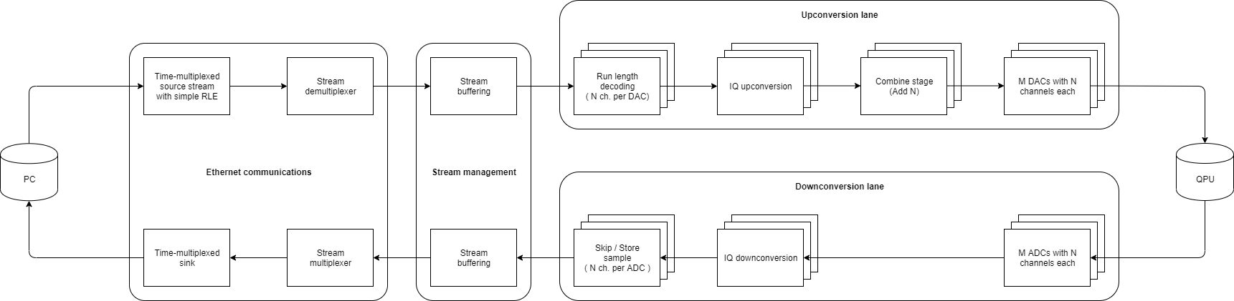
Dataflow diagram
Notes:
SLIDE 7
Illustrated: the overall dataflow diagram. This image does not illustrate
block-by-block what you are expected to implement. It outlines the over-
arching dataflow plan of the device; you are implementing modules to achieve
this overall dataflow plan.

Slide 8
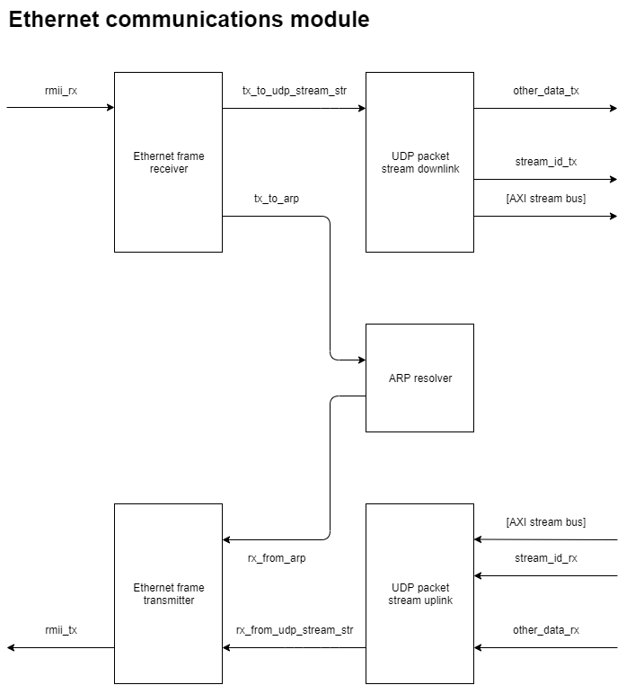
Ethernet communications module
Notes:
SLIDE 8
Ethernet communications
Key terms:
- Physical Ethernet
- UDP
- RMII
- ARP
- AXI
This is a custom module. To enable high-speed data streaming from the host-PC,
many modifications must be made to 'typical' Ethernet communication designs.
Yet, to keep this module bare-bones enough to be suiting for DAT096, we have
also kept the amount of specified modules to a minimum.
From the PC, the operator will stream data using off-the-shelf, standard
Ethernet frames. We have specified this project to operate using UDP,
although you are expected to treat all frames regardless (aka. don't simply
throw away non-UDP-containing frames).
Should UDP be detected, and be within the specified port numbers 30000-30255,
then this is a valid data stream packet. This will be sent onwards to the
central stream controller.
Packets that do not conform to this is to be sent onwards into the system.
Typically, this will be your control signals for all kinds of modules in
your design, such as selected frequency for the upconversion NCO.
There may also be so-called ARP requests. You are expected to treat these
using an ARP resolver module. This is so that you don't have to set MAC
manually for a static IP on the host-PC operating system. Mainly as this is
usually bound to admin-right issues.
It is adamant that your design is non-host-PC-CPU dependent.
The custom package format sent in the data payload is illustrated in a
separate document. Basically, the first 16 bits will contain the data stream
index, the following 16 bits the I-component of the waveform, and the last
16-bits the Q-component of the waveform. In total, expect at least
a usable payload of 48 bits.
The interface from the Ethernet communications module to the central stream
controller will be over AXI bus. This is true for almost all datastream
buses in the system. Likely, you will want to separate the stream index
at this early stage; it is best to leave the dataflow path to *only*
datastream payloads.
The upstream to the host-PC is identical to the downstream one, of course in
reverse. You are expected to conform to RMII, since this is what the Nexys 4
board uses in its Ethernet communications.

Slide 9
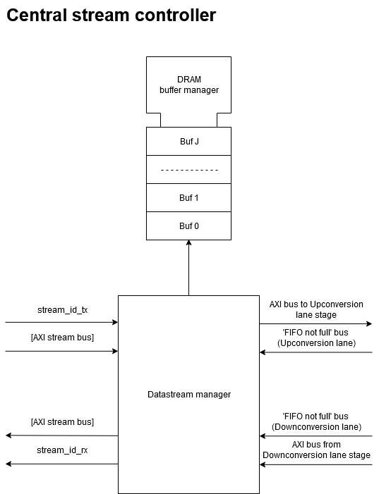
Central stream
controller
Notes:
SLIDE 9
Central stream controller
Key terms:
- Stream management
- FIFO buffering
- DDR DRAM
- BRAM cells
This block has on purpose been left up to interpretation, as it will differ
greatly between groups.
At any time, you may receive datastream packages from various sources in the
system. These will have to be managed to ensure that the output stays in sync,
and is constant.
Some package will at some time be inserted into this controller from the
Ethernet communications module. Its job is thereafter to look at the package
index, and send its to the target FIFO buffer. Keep in mind that you are
recommended to keep the number of writes to a minimum, thus typically the
size of a slice in the FIFO buffer will typically equal that of a DRAM one.
Meaning that the DRAM memory slice in question, containing several
datastream payloads, is typically transferable as-is to the FIFO
when the fifo_not_full signal is lit.
You are greatly encouraged to look into the capabilities of the board,
such as its DDR DRAM. Although not necessarily required, for instance
if your design is fully operational using BRAM cells.
This block will likely lead to a lot of contraints in your system, you are
recommended to illustrate your dataflow using higher-level tools beyond
blank VHDL on a screen. This will make it easier for whomever reads your
final documentation as well.
The bus annotations to the right of this image (M x N AXI) are misleading,
please refer to more updated documentation.

Slide 10
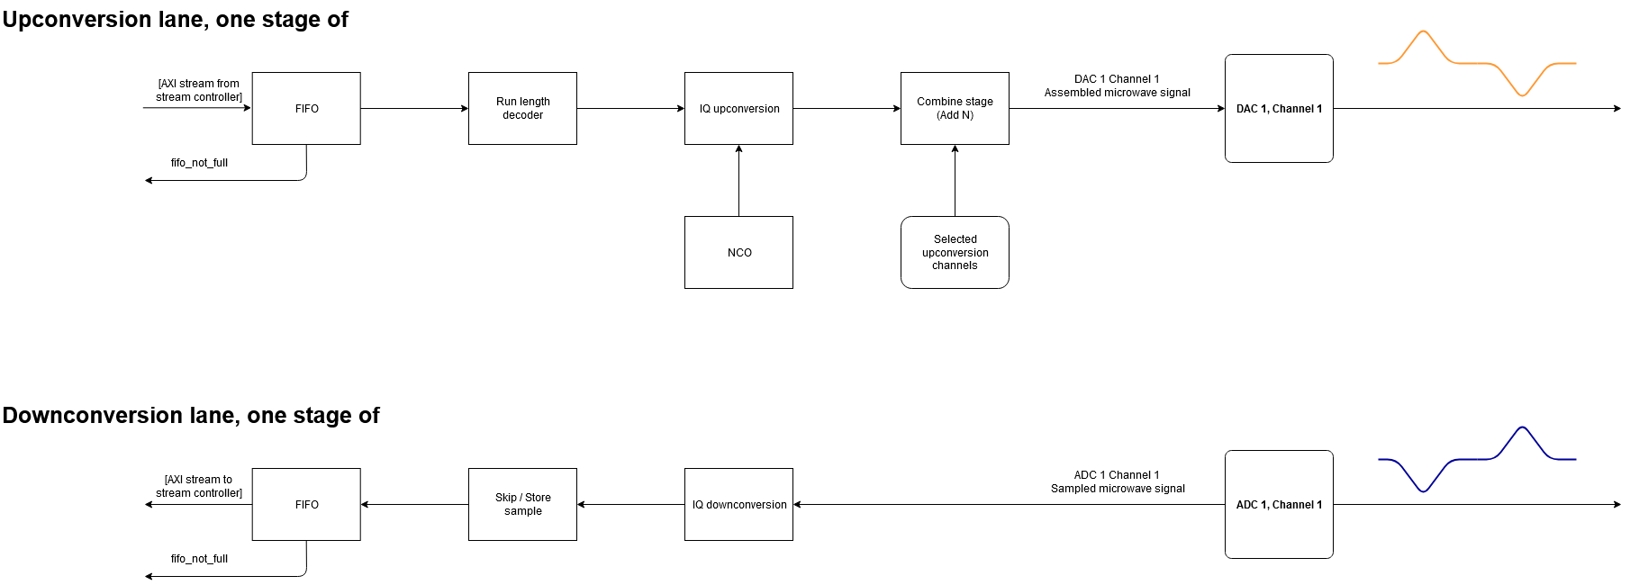
Upconversion lane
Notes:
SLIDE 10
Upconversion lane stage
Key terms:
- FIFO buffer
- Run length encoding
- NCO
- IQ mixing (this is a big one)
The target FPGA DAC (and ADC) has eight parallel slots expected to be written
to at a speed of 500 MHz. These are then read out successfully to generate
a GHz output.
Meaning, you have to treat 8 simultaneous data samples.
These may arrive at random times, thus to keep the data pace constant,
your upconversion lane will contain a FIFO buffer at the beginning.
One slice of the FIFO buffer typically contains several payloads.
The payloads in turn contain the I and Q components of the signal sample,
needed in you IQ mixing block.
The FIFO is expected to be able to signal to the controller that it may be
filled up with additional content.
Not illustrated: control lines to (pretty much) every module, from some host
module that you steer using the 'other_data' line in the Ethernet
communications module.
Typically, sending 150 zeroes one-after-another is not that useful.
Thus, you are expected to implement very basic RLE. Through some command
structure, controlled using the control signal host, this block is expected
to be able to output said 150 zeroes when deemed necessary.
The qubit system is sensitive. We do not want to flood the QPU core with
unneccesary frequency content from sideband mirrors. Thus, you are expected
to implement IQ mixers into the upconversion stages. These in turn require
numerically controlled oscillators. These will in turn be settable by the
operator, which provides immense flexibility in quantum experiments.
Remember: the qubit must receive data in its expected frequency range,
otherwise you fall down the rabbit hole to the quantum fairyland.
Meaning that IQ-mixing will have to be part of the final device.
We do know that the ADC / DAC has a built in IQ-mixer, *but* it is only
capable of mixing with a fixed frequency.

Slide 11
Notes:
SLIDE 11
(Zoomed-in upconversion lane stage)

Slide 12
Notes:
SLIDE 12
(Zoomed-in upconversion lane stage)

Slide 13
Downconversion lane
Notes:
SLIDE 13
Downconversion lane stage
See upconversion lane stage, this is a reversed mirror image of the former,
apart from the skip/store block.
The skip/store block will be your fundamental tool for windowing a received
waveform. The operator should be able to specify that everything outside
a 5-8 µs window should be discarded, for instance.

Slide 14
Notes:
SLIDE 14
(Zoomed-in downconversion lane stage)

Slide 15
Notes:
SLIDE 15
(Zoomed-in downconversion lane stage)

Slide 16
Important notes on frequency conversion
The sinusoid generator sub-block can easily become your greatest adversary if not taken seriously.
Troves of academic matter exist on how to produce the perfect sine wave.
Same goes for IQ mixing, you should get to know the equations (not very hard).
Notes:
SLIDE 16
A general notice, warning if you may, is that sinusoidal generators and IQ-
mixers may easily take up a lot of your time if you are not careful.
Or, if you manage to get such a solution working, you might even want to
play with the DSP designing tools available through Matlab toolboxes.
I personally advice against this solution in this course.

Slide 17
Quick notes on testing
Loopback is king
Generating test waveforms can be done on the fly
Even though ‘broken’ qubits can be faked using C-LC filters, your focus should lie on digital development techniques, actual DAC/ADC-work is best performed on the final FPGA platform.
Notes:
SLIDE 17
For testing, you are advised to rely on looping back your digital signals
wherever you wish to test them.
Should you want to procure input signals, corresponding to actual quantum
experiments, let me know and I'll generate these on the fly.
Extremely likely, I will upload a broad set of test signals for you to
experiment with either way.

Slide 18
Documentation to get you started
Project introduction
Module map
Module map specification document
Hints on testing
Dataflow diagram
… likely more content
Notes:
SLIDE 18
Documentation in this project will be plentiful.
If not straight away, then as soon as possible.
We have knowingly used existing protocols etc. with documentation widely
available practically anywhere online. Frankly, our spec. for (for instance)
an Ethernet frame from the PC would pretty much be a copy of the Wikipedia
entry.
More precise specifications can of course be arranged.

Slide 19
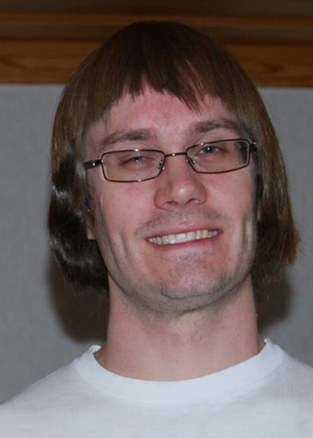
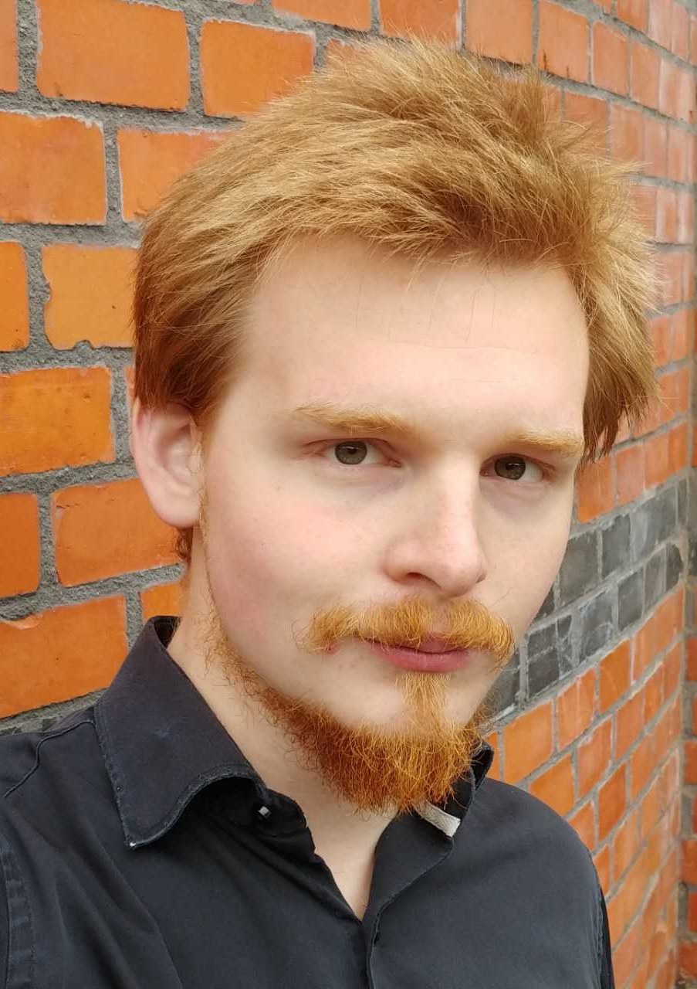
People
Mats Tholén
Ph.D. student, WACQT
Intermodulation Products AB
Handles specification to product owner
Christian Križan
Research engineer, QTL, MC2
krizan@chalmers.se
DAT096
Project teams
DAT096
Project teams
DAT096
Project teams
Product owner
Notes:
SLIDE 19
We are the people behind this project. Myself, Christian, will be your product
owner. Please direct all your questions to me, I listen very actively to my
e-mail, krizan@chalmers.se.
The questions which arise are likely to be shared by many, don't be
surprised if I post a bulletin or similar explaining your question + answer in
further detail.
At times, I may have to "refer up a level" to the specification source of this
project, Mats Tholén. He wishes to be kept out of communication, as he is busy
with other projects.
Do note: Mats is associated with a company, Intermodulation Products AB.
Mats is interested in co-ownership rights to your code (note: not total
ownership transferal). The conversation is ongoing, and a contract is
underway.

Slide 20
Notes:
SLIDE 20
Final slide.

