Slide 1
Notes:
SLIDE 1
Opening slide.

Slide 2
2020-02-06 Technical information
Contract status feat. Lena
Additional documentation
Topics related to the
Up- / Downconversion stages
Questions and their answers
IQ mixing concept introduction
Christian Križan
Research engineer, QTL
krizan@chalmers.se
C. Križan, ORCID: 0000-0002-5059-7998
Notes:
SLIDE 2
General welcome slide. This lecture will, along with other content, cover
the current company contract status (this part will be discussed further
on in the lecture by Lena), what documentation has been added since last time,
topics regarding up/downconversion - similar to what was discussed last time
regarding the Ethernet communications module, questions and their answers,
and finally introductory concepts to IQ mixing strategies for those who have
never heard of the concept.

Slide 3
Contract status
Notes:
SLIDE 3
The contract has been finished, the plan is that you sign it on the 7th of
February. This is a modified Chalmers product development contract.
I have taken the liberty to cut out sections of the contract that I believe
is not relevant to this course, and many IMO excessive rights signed over
to the company regarding what rights you have - and more inportantly,
do not have.
In the end, what you'll be signing in short is:
- Mats is added as owner to the code.
- Mats gets to take said code and use it for commercial purposes.
- You are not to smack an OpenSource license onto the code and distribute it
freely online, where competitors to Intermodulation Products may simply
download your code and synthesise it for their own FPGA without buying
the real deal.
The detailed terms and conditions are handed out on this lecture for you
to see until tomorrow.

Slide 4
Added content since last time
General notes on development and testing procedures
- Hints on testing, development suggestions, the minimal system
Updates in the module descriptive document from last lecture
( Student contract )
Datasheets
- Target platform ADC/DAC
- The PHY chip on the Nexys 4
As usual, lecture slides with additional notes
Notes:
SLIDE 4
Since last time, there have been updates to the Canvas specification content.
This includes, although is not limited to:
- A document outlining a set of suggested development procedures, as well as
hints on testing during the development of this device. This document
also outlines what would be the minimal viable system as well as what
your priorities would be during development.
- What has been said during lectures / questioned about etc. has been added
to the Module specification document. Yet again, if there is content
missing - feel free to contact me so that I may forward it to the other
groups.
(- A student contract has been made.)
- I have distributed the datasheets to the PHY chip on the Nexys 4, as well
as the ADC/DAC on the Xilinx Ultrascale+ RFSoC. The latter is in fact
a good read for anyone who wishes to get into data conversion.
- The lecture slides have been annotated and uploaded onto Canvas.

Slide 5
IF, FIFO and IQ
frequencies
Notes:
SLIDE 5
When designing, you will have to take a lot of decisions regarding for instance
what frequencies to design for and the lot. It is highly relevant for this
project that you are given a frequency set ansatz.
The main goal is to aim for a constant frequency ratio when comparing
stages in the target platform and the development one.

Slide 6
IF, FIFO and IQ frequencies
Clocking FIFOs at 100 MHz was insufficient in Mats’ earlier experiments.
Meaning that you should aim for a design which would allow for the maximum IF frequency if possible.
… see next slide
Notes:
SLIDE 6
Earlier, Mats and co. have noticed that clocking the central stream controller
(or its previous equivalent) at 100 MHz have been insufficient for a
sufficiently adequate datastream output. Meaning that the target platform
must go much higher.
Preferably, you should design for the fastest possible system you can get
working on the development platform.

Slide 7
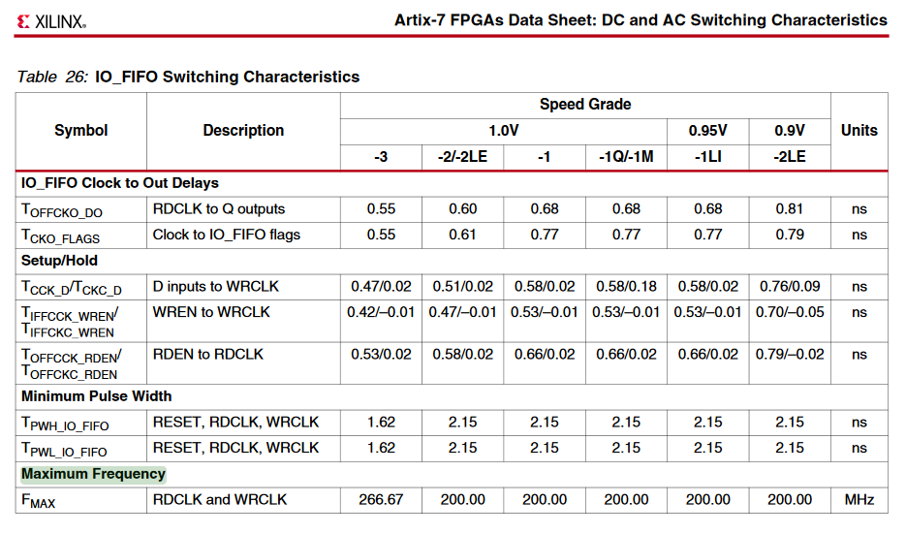
Notes:
SLIDE 7
If we look in the datasheet of the particular Artix 7 present on your
development board, we can see that one of the most limiting factors when
designing the central stream controller are the FIFOs at its periphery.
These have a maximum operational frequency of 200 MHz. This in turn
will serve as a benchmark for the target ratio on slide 9.

Slide 8
IF, FIFO and IQ frequencies
Clocking FIFOs at 100 MHz was insufficient in Mats’ earlier experiments.
Meaning that you should aim for a design which would allow for the maximum IF frequency if possible.
… given that nothing breaks, such as insufficient space constraints.
Remember:
Implementations relying solely on a single fixed clock frequency tend to cut corners,
and generally end up being hard to work with in the end.
Make your design sufficiently generic without relying on the clock rate.
Notes:
SLIDE 8
In the earlier stages of your design, you could definitely design with a
fixed clock frequency in mind. Although such designs tend to cut corners.
When synthesising for the target platform, you will make it easier for
everybody if you keep your design as generic as possible (considering
operating frequencies) without making it too hard for your development.

Slide 9
More on IF, FIFO and IQ frequencies
The target platform maximum FIFO clock rate is 500 MHz (516 actually).
Scaling down with the same ratio (500/200), a fictitious development board ADC/DAC
should input/output at 4000/2.5 = 1600 MSa/s.
Meaning:
Your IF stream rate should be 100 MHz.
Your IQ mixers should up/downconvert with a factor of 2.
With eight parallel samples – we achieve an effective sample throughput of 1.6 GSa/s.
Not bad for a 100 MHz main system clock.
Notes:
SLIDE 9
Comparing now the FIFOs of the central stream controller, we see that
the target FPGA platform has a maximum FIFO clock frequency of 516 MHz.
Let's keep it simple and say that this number is 500 MHz.
Meaning, that your scale-up reference is 2.5 - frequencies and similar
in the development design will end up 2.5 times larger in the final platform.
IF this development platform, the Nexys 4, had a representative ADC/DAC,
it would achieve an output sample rate of 1.6 GSa/s.
In short, your IF stream rate will be 100 MHz. Your IQ mixers will upconvert
with a factor of 2. Processing eight parallel samples will mean an
effective sample throughput of the sought 1.6 GSa/s, as would be expected
from scaling.

Slide 10
200 MHz?
But wait, the main system clock is 100 MHz?
You will have to use tricks from IP cores, such as the MMCM (Mixed-Mode Clock Manager) including PLL. Clock multipliers are definitely a thing, especially in digital radio applications.
Spoiler below (copy-paste whitetext to see):
There is even a ready-made wizard for this, if you know where to look.
Just for additional reference, the 100 MHz clock rate will also scale with a factor 2.5 on the target FPGA platform. Meaning that the target board will run its stream controller FIFOs at
250 MHz.
Notes:
SLIDE 10
So how do you achieve a 200 MHz clock when the main system clock is 100 MHz?
Well, you will have to use one (or several) of the six included MMCM + PLL
modules. These include some clever tricks to convert a clock rate to another.
I strongly object to you designing your own MMCM + PLL loop, since this
is available as an IP core configuration onboard. Also, unless I'm mistaken,
the synthesis tool will know what to include from the hard-silicon
circuitry - which might not be inferred from your design.
Also, for reference, this IF stream rate will also be scaled with a factor
of 2.5 on the target FPGA platform. Meaning that the target platform
will have a central stream controller clocked at 250 MHz.
But, it also has support for GMII (XGMII even?) - so don't think just yet
that your data management will be easier because of this upscaling.

Slide 11
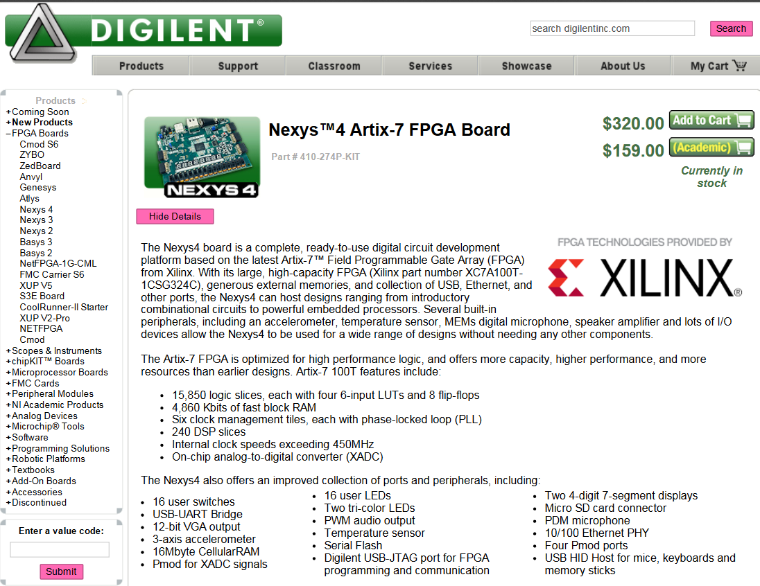
By the way
Notes:
SLIDE 11
Your teachers this far might have been rather adamant that the maximum
clock frequency attainable on the Nexys 4 is 100 MHz.
To this, I will quote two people from industry that
"They may set the clock rate however they want"
... of course, there are upper bounds, ideating that you may not specify
a 500 THz clock rate and get away with it.
As you even se here, the internal clock rate is advertised far beyond the
100 MHz main system clock.

Slide 12
Let’s talk about filters
Notes:
SLIDE 12
We'll now head into filter territory.

Slide 13
Filters
You’ll notice that a lot of places in your DSP design benefit from filtering.
NCO’s, mixers and filter tap memories can quickly consume a lot of LUTs. Since your design will contain a heavy amount of asynchronous parallelisation, using the large amount of available BRAM on the Nexys 4 might prove impossible.
“A design based on interpolation + FIR + mixer is not normal in the business. You should look into CIC.”
- Mats
CIC filters will droop in the passband. Meaning that, if you go with CIC filtering, you’ll typically need an impulse response filter afterwards. Yet, IRL, the operator could theoretically plug in a compensator in the signal generator and compensate before the signal even enters your system.
But the take-home message is:
The quality of your filters will depend on your implementation, and is a typical metric that your group will try to engineer as optimal as possible.
Besides, the engineering choices here constitute pretty good stuff for your report.
Notes:
SLIDE 13
At seemingly random occasions, you will have to include filters in your design
for a broad range of reasons. This is common in DSP work, and will certainly
be required in your up-/downconversion stages.
Be wary though of the risk that you may quickly run out of available space.
Simple impulse response filters tend to be very large. The standard academic
approach of interpolator -> FIR -> upconversion may be a consuming design
choice. You will have to see yourselves what appears to be a good/bad design.
To quote Mats,
“A design based on interpolation + FIR + mixer is not normal in the business.
You should look into CIC.”
Do note that you may have to eventually move out of your comfort zone and
start implementing new filter types.
Slight hints for a CIC filter: these droop in the passband, commercial
implementations tend to have additional compensating FIR filters attached
to the FIR filter in order to compensate for its behaviour at various bands.
One could imagine that IRL, an operator could compensate for this droop
already at the host PC level. The operator could potentially apply
some initial digital amplifier passband-effect in code.
To be frank, I am myself unsure how I would implement this when writing a
potential plug-in for the software we use to generate qubit control waveforms.
So don't count on it.
See rest of text in the slide.

Slide 14
Filters cont.
OK. So what do I plug into t-filter? [1]
I would start with a very flat passband at 0.1 dB ripple and -30 dB noise suppression.
This we know yields rather decent filters on the Nexys 4 hardware.
[1] http://t-filter.engineerjs.com
Notes:
SLIDE 14
If I was a student in this project, I would want to know:
what are the basic metrics I can use in order to get going?
Well, that's a bit hard to say since we don't know what will be the limiting
factors ourselves. But, to at least give some numbers: if you're starting
out at a simple implementation with FIR filters and the lot that you have
learned in previous courses, I would say go for a 0.1 dB ripple passband and
an attenuation of -30 dB.

Slide 15
Answers to questions
Notes:
SLIDE 15
Reading this paragraph took more time than reading the slide itself.

Slide 16
Vivado IP blocks are 100% OK
Provided you did not buy them for this project yourselves.
Notes:
SLIDE 16
To answer the question of IP blocks: *yes* - IP blocks, if included in Vivado,
is perfectly fine in this project. Self-bought IP blocks, are not.

Slide 17
Questions and answers
Should we package the outgoing data to the host PC as UDP also?
Yes please, this would make it easier.
Does the Central stream controller also ask the host PC for data when its memory is not full?
“This is a good point. Yes, it should.” This means that, if there is no incoming data into the DRAM, and the DRAM can accept additional packages, then the Central stream controller should poll the Ethernet communications module to ask the host PC for more data.
On the topic of the skip / store block:
There may be advantages in the downconversion path gained by setting the skip / store block directly after the ADC input. If your memory is sufficient, you sure could try.
Notes:
SLIDE 17
See text in slide.

Slide 18
More answers
I should clarify that the QPU core is a passive device.
An RF signal goes in, a modified RF signal goes out.
There are no mixers in the signal path leading to/from the core after your interface device.
There are 12 GHz LP filters, circulators, and attenuator-amplifier pairs at best.
The qubits themselves act as frequency-dependent C-LC filters.
See my thesis on Canvas for details.
You should not have to squash spurious contaminants in the output of the IQ mixer,
by for instance applying a bandpass filter.
Harmful spurs similar to LO-leakage spikes, are IRL squashed by the operator by
calibrating the amplitude and phase of the NCO’s.
Notes:
SLIDE 18
In many applications you find online, you typically see that the IQ streams
are combined back again to form some real signal.
But, do keep in mind, that every data stream sample contains an I and Q
component. This in turn will form what you need for the upconversion.
And, on the way back, you'll acquire another I and Q stream.
To iterate: the QPU is a passive device.
See text in slide.

Slide 19
IQ mixing
Notes:
SLIDE 19
The rest of these slides will introduce the IQ mixing field to those of you
who have never experienced mixers, and the fact that we may move
frequency content in the spectrum more-or-less freely.

Slide 20
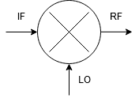
Let’s start with just mixing
Mixers, analogue or digital, are used for blending two incoming signals – producing signals at new output frequencies. They receive some frequency band content, and put said content at some other frequency band. Frequency converters, if you may.
A key component in all of radio technology, invented almost 120 years ago.
The mixed output of fIF and fLO yields two new signals. We’ll combine these and call them fRF.
fRF = [fIF+fLO] + [fIF+fLO]
Notes:
SLIDE 20
See text in slide.

Slide 21
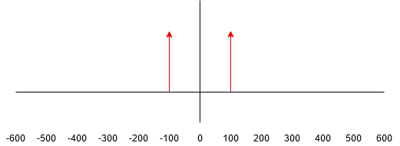
Some real content
Notes:
SLIDE 21
Let's imagine some signal at 100 kHz. The order of magnitude is not important.
The Y-axis represents the amplitude of the signal.
This signal is "real" - which means that the content to the right of the
Y-axis must be mirrored (even) about the Y-axis.
I like to think of it personally as cos(f) = cos(-f).
(Commonly in literature, cos is used to describe real parts in signals.)

Slide 22
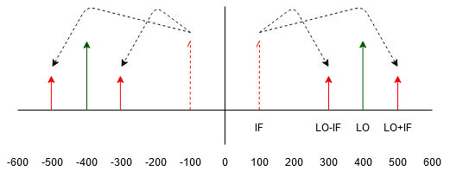
Some real content
Notes:
SLIDE 22
These combined signals yield two new spikes in the spectrum
after mixing. These new spurs will appear at the distance |0-IF| from
the LO spike. Do note that their amplitudes have been halved.

Slide 23

$$\cos{ω_{1}}\cos{ω_{2}}= \frac{\cos{(ω_{1}+ ω_{2})}}{2}+ \frac{\cos{(ω_{1}− ω_{2})}}{2}$$
Notes:
SLIDE 23
The normal real mixer is rather easy to explain using this picture.
Do note that this mixer is for upconversion, ie. IF and LO are used
as an input while RF outputs our mixed waveform.
You'll see RF and IF switching roles in literature online, the
reason being up/downconversion respectively.
Please observe the multiplication cos*cos

Slide 24
So a mixer is just a multiplication?
In the digital domain, yes.
Notes:
SLIDE 24
This slide is more important than you first may think.
In the digital domain, mixing is just a multiplication.
Unless you do something really interesting, this multiplication will be
commutative across your entire signal path.
Meaning that this multiplication does not have to happen were you'd
typically expect it to (at "the end" of a typical upconversion).
If you consider your signal, and draw it on paper, you see that you
end up with the same result if you multiply the signal already
at the beginning of said typical upconversion. And this is the whole
point of so-called translation filters.

Slide 25

What is the deal about IQ then?
In phase and quadrature components, ie. one original signal $ω_{I}$ and its 90° phase-shifted copy $ω_{Q}$, allow for breaking the Y-axis symmetry.
You’ll likely se literature calling this ‘complex mixing’ – since we are rather equivalently
operating in the complex plane. The resulting signals are also known as complex signals.
The signal is only complex because you observe both I and Q together.
On their own, they are still very real signals.
… and if you were to probe a multimeter to an output bearing the summation of I and Q,
you’d still see Y-axis symmetric frequency content. The signal is real, after all.
Notes:
SLIDE 25
See text in slide.

Slide 26
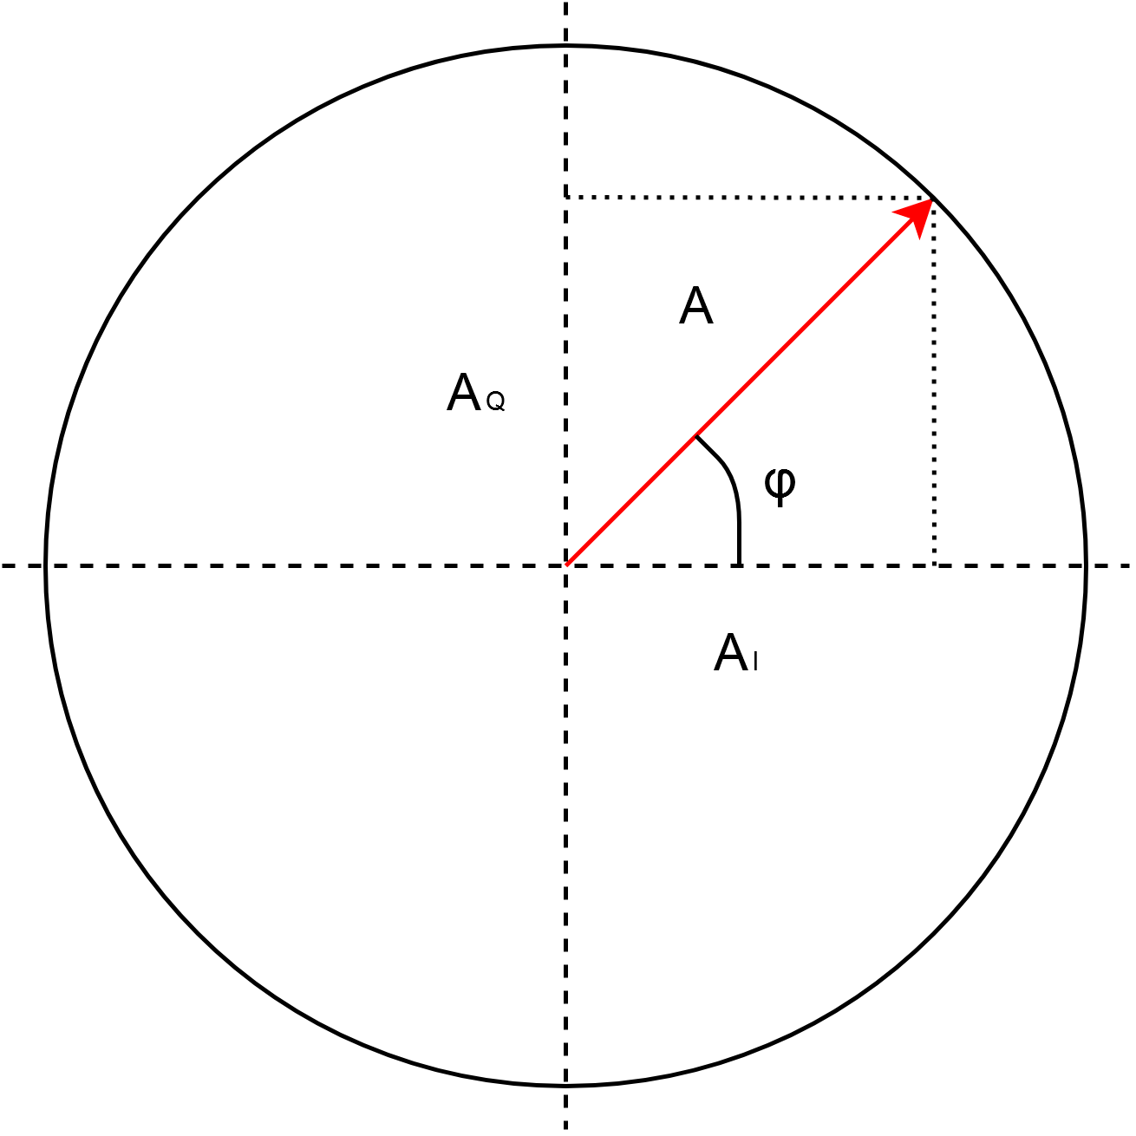
IQ by vector diagram
The amplitude of the Q-component in a way represents the imaginary axis, while the I-component represents the real.
| ”I + Q” | is thus the amplitude of A,
while the phase of ”I+Q” is φ
Notes:
SLIDE 26
A is in this image the "I + Q", it is a signal detailed by using the
amplitude of the I component as the X-axis composant, and by using the
Q component amplitude as the Y-axis composant.
[Phi] is in turn the phase of "I + Q".
Meaning also, that at no point can you probe your circuit with a dumb
multimeter and read out the amplitude of A. A is a resulting vector
from having the complete information in I and Q, without any of these
components - you no longer have a complex representation.

Slide 27
The point
We may use the complex plane
to describe any signal
Notes:
SLIDE 27
... which allows for an incredible toolbox in signal processing.

Slide 28
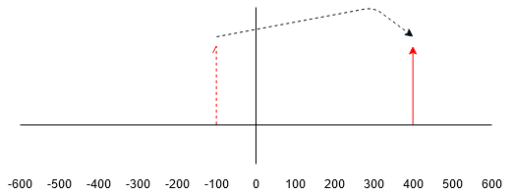
And why should we use it?
Every data sample contains the I and Q part of the target signal. By operating in the complex plain, the operator may easily specify some content at only -300 kHz or similar.
An IQ mixer allows for moving this single spike to some target frequency, without generating conflicting spurs.
Notes:
SLIDE 28
See text in slide.

Slide 29
With this basic idea, go wild
There are hundreds of IQ tutorials online.
Notes:
SLIDE 29
These ideas were meant to introduce you to the concept, and not to explain
a deeply algebraic meaning. There is an incredible amount of content
available that does a great job of introducing every detail that goes
into the IQ concept.

Slide 30
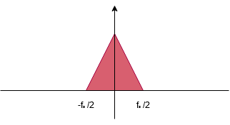
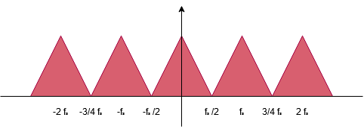
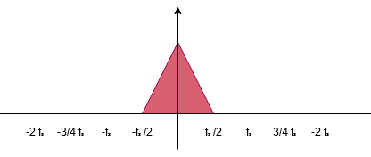
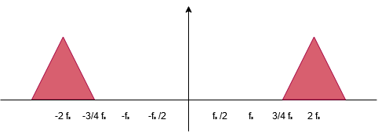
Some final notes on interpolation, filtering, mixing
1
2
NOTE: amplitude
changes disregarded
3
4
Notes:
SLIDE 30
These slides represent a typical academic way of explaining frequency
upconversion. Let's say that you start out with some frequency content
as shown in (1). The sample rate is f_s.

Slide 31
Open-class questions
My mailbox is open: krizan@chalmers.se
Notes:
SLIDE 31
Time for open-class questions, if you got any.
Or send these to me at any time,
krizan@chalmers.se

Slide 32
Notes:
SLIDE 32
Final slide.

