Slide 1
Geometric design rules Postlab lab 2 Prelab lab 3

Slide 2
Week 4
Monday lab2
Carry gate schematic
Tuesday
Lecture Layout of CMOS gates
Thursday
Postlab review lab 2
Geometrical design rules incl. prelab 3
Tutorial POTW Layout (Victor)
Friday Deadline prelab 3
Layout of carry ckt of full adder

Slide 3
Practical things
Thursday morning consultation time moved to 9.15-10 starting next Thursday
Lars Svensson will help out with lab 3
Mid-course meeting with student representatives held today.
Cadence remotely with VPN?
Chapter 2 problems?

Slide 4
From MUD cards
How should metal line overlap contacts?
Why do we connect input to V_{DD} on the second connection point on P-substrate?
Euler path
How to draw it through odd and even nodes.
How to convert path to layout.

Slide 5
Inverter mask set and fabrication
P-type silicon substrate
P+ select
Poly gate
Contact cuts
Active areas
Metal wires
N-well
Notes:
From which direction do we see things?
The answers here are correct but there is a very important additional reason why a p-type substrate is preferred.
NMOS transistors are faster than PMOS transistors all else being equal. To make n channel MOS, the well must be p type. To get the maximum electron mobility, the p should be as lightly doped as practical. If an n type substrate were employed that would mean that the n channel MOS would be made with the addition of a p well. This p well would need to have a significantly higher doping than the n type substrate (each added dopant must be an order of magnitude higher than the background dopant). Now the p is higher than it needs to be for the n MOS.
Although most of the circuitry is CMOS (PMOS + NMOS gates), critical components that must run fast are exclusively NMOS. The fastest NMOS is obtained with a high resistivity p-type substrate, not a lower resistivity p-well in an n-type substrate.
The conventions came after this insight into performance.

Slide 6
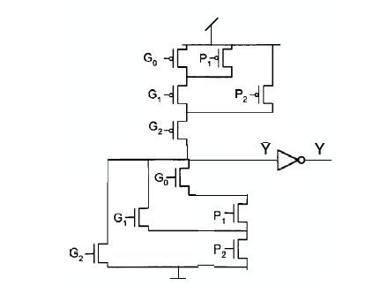
Example Euler paths
It is a good idea to label the circuit nodes that are neither the output, nor VDD or VSS.
I have done so here.
There are four such nodes:
A, B, C, D.
A
B
C
D

Slide 7
Example Euler paths
How many transistors are connected to each of the circuit nodes in the p-net?
VDD: 3
A: 3
B: 3
Y’: 1
For an Euler path to exist there can only be 0 or 2 vertices (that is circuit nodes) with odd number of edges (that is transistors).
So with this schematic for the p-net there is no Euler path.
A
B

Slide 8
Example Euler paths
How many transistors are connected to each of the circuit nodes in the n-net?
VSS/gnd: 2
D: 3
C: 2
Y’: 3
There are two vertices (circuit nodes) with an odd number of edges (transistors). Thus, an Euler path can be formed. It has to start and end in the circuit nodes with odd number of transistors: The output, Y, and internal node D.
C
D

Slide 9
Example Euler paths
We have to start in a odd node and end in the other odd node.
Here is one solution.
There are several
other possibilities.
C
D

Slide 10
Example Euler paths
G0
P1
G1
G2
P2
To map Euler path to a continuous line of diffusion
start by labeling the transistors with their signal name starting at one end of Euler path.
(If some signals appear more than once give unique names)
C
D

Slide 11
Example Euler paths
Y’
C
D
Y’
VSS
D
G0
P1
G1
G2
P2
Then label also the circuit nodes along the path.
C
D

Slide 12
Example Euler paths
Y’
C
D
Y’
VSS
D
×
×
×
×
×
G0
P1
G1
G2
P2
C
The make the connections for the source-drain areas that have the same circuit- node label.
I just draw it as a stick diagram here.
D

Slide 13
Example with quiz
Draw the schematic for a static CMOS gate with the logical function:
f=(A∙B+C∙D)∙(E+F+G)
The n-net can be laid out with single line of diffusion. T/F
The p-net can be laid out with single line of diffusion. T/F
Can you make the order ABCDEFG work for the n-net?
Can you make the order ABCDEFG work for the p-net?

Slide 14
Postlab 2

Slide 15
Prelab 2
Design task: design with MOSFETs the carry bit-cell for an 8-bit ripple-carry adder!
The 8-bit carry logic is to be implemented by an iterative logic array consisting of eight instances of the bit-cell that you have designed.
The carry bit-cell has three inputs (two bits a, b and a carry-in memory bit), and one output, the carry-out memory bit to the next more significant bit.

Slide 16
Iterative logic arrays: FULL ADDER
Adder word slice
Find Boolean equations from truth table!
a₀
b₀
c_{out}
FA
c_{in}
Sum₀
a₇
b₇
a₆
b₆
a₅
b₅
a₄
b₄
a₃
b₃
a₂
b₂
a₁
b₁
a₀
b₀
FA
FA
FA
FA
FA
FA
FA
FA
c_{out}
c_{in}
Sum₇
Sum₆
Sum₅
Sum₃
Sum₃
Sum₂
Sum₂
Sum₁
Sum₇
Sum₆
Sum₅
Sum₄
Sum₁
Sum₀
Sum₄
Sum₀
Notes:
One of the main themes of this course is the design of n-bit adders. For starters, we will do that by designing the adder as an iterative logic array. For this, we need to design one Full Adder cell as the one shown here. We will use the methods discussed in this lecture to design the cell with MOSFETs from the Boolean truth table.
Then we will build an iterative logic array from many instances of this cell.
The two numbers to be added are enetered at the top. The carry-in is entered to the LSB (least significant bit) to the right. As the carry ripples from cell to cell, from right to left, the sums pop out at the bottom.

Slide 17
Iterative logic arrays: FULL ADDER
Find Boolean equations from truth table!
a₀
b₀
c_{out}
FA
c_{in}
Sum₀
Design full adder by divide and conquer
a₂
b₂
a₁
b₁
X4
X2
X4
X2
c_{out}
Carry logic
c_{in}
c_{out}
Carry logic
c_{in}
Design 8-bit full adder as an iterative logic array!
SUM logic
Size of
SUM cell?
SUM logic
Sum₂
Sum₁
Notes:
One of the main themes of this course is the design of n-bit adders. For starters, we will do that by designing the adder as an iterative logic array. For this, we need to design one Full Adder cell as the one shown here. We will use the methods discussed in this lecture to design the cell with MOSFETs from the Boolean truth table.
Then we will build an iterative logic array from many instances of this cell.
The two numbers to be added are enetered at the top. The carry-in is entered to the LSB (least significant bit) to the right. As the carry ripples from cell to cell, from right to left, the sums pop out at the bottom.

Slide 18
Iterative logic arrays: FULL ADDER
Find Boolean equations from truth table!
Propagation delay estimation:
Assume carry cell has logical effort g and parasitic delay p.
8-bit adder delay: A first crude estimate!
d=8×(p+g×2+p_{inv}+1/2)≈8×10=80 → t_{pd}= 400 ps
Corresponding to 1.25 GHz clock frequency
But load from SUM cell was neglected and will slow down the design!
a₀
b₀
c_{out}
FA
c_{in}
Sum₀
a₂
b₂
a₁
b₁
X4
X2
X4
X2
c_{out}
Carry logic
c_{in}
c_{out}
Carry logic
c_{in}
Design 8-bit full adder as an iterative logic array!
SUM logic
Size of
SUM cell?
SUM logic
Sum₂
Sum₁
Notes:
One of the main themes of this course is the design of n-bit adders. For starters, we will do that by designing the adder as an iterative logic array. For this, we need to design one Full Adder cell as the one shown here. We will use the methods discussed in this lecture to design the cell with MOSFETs from the Boolean truth table.
Then we will build an iterative logic array from many instances of this cell.
The two numbers to be added are enetered at the top. The carry-in is entered to the LSB (least significant bit) to the right. As the carry ripples from cell to cell, from right to left, the sums pop out at the bottom.

Slide 19
Designing the carry cell
VDD
A
B
A
A
B
C
≥1
B
C
&
≥1
A
&
D
E
A
B
A
B
B
VSS

Slide 20
Designing the carry cell
VDD
A
B
A
A
B
C
≥1
B
C
&
≥1
A
&
A
B
A
B
B
VSS

Slide 21
Designing the carry cell
VDD
Logical effort g=2,
Parasitic delay p=4p_{inv}
A
4
B
4
4
A
4
A
B
C
≥1
4
B
C
&
≥1
2
2
A
&
A
B
A
2
B
2
2
B
8-bit adder delay: Improved estimate w pinv = 0.9
d=8×(p+g×2+p_{inv}+1/2)≈8×(5p_{inv}+2×2+0.5)=72→ t_{pd}= 360 ps
VSS

Slide 22
2015 hand-in examples
___ c_{out}
c_{out}
c_{in}

Slide 23
2015 hand-in examples
a₀
b₀
c_{in}
Carry logic
c_{out}
Design structure chosen by a number of 2015 students!

Slide 24
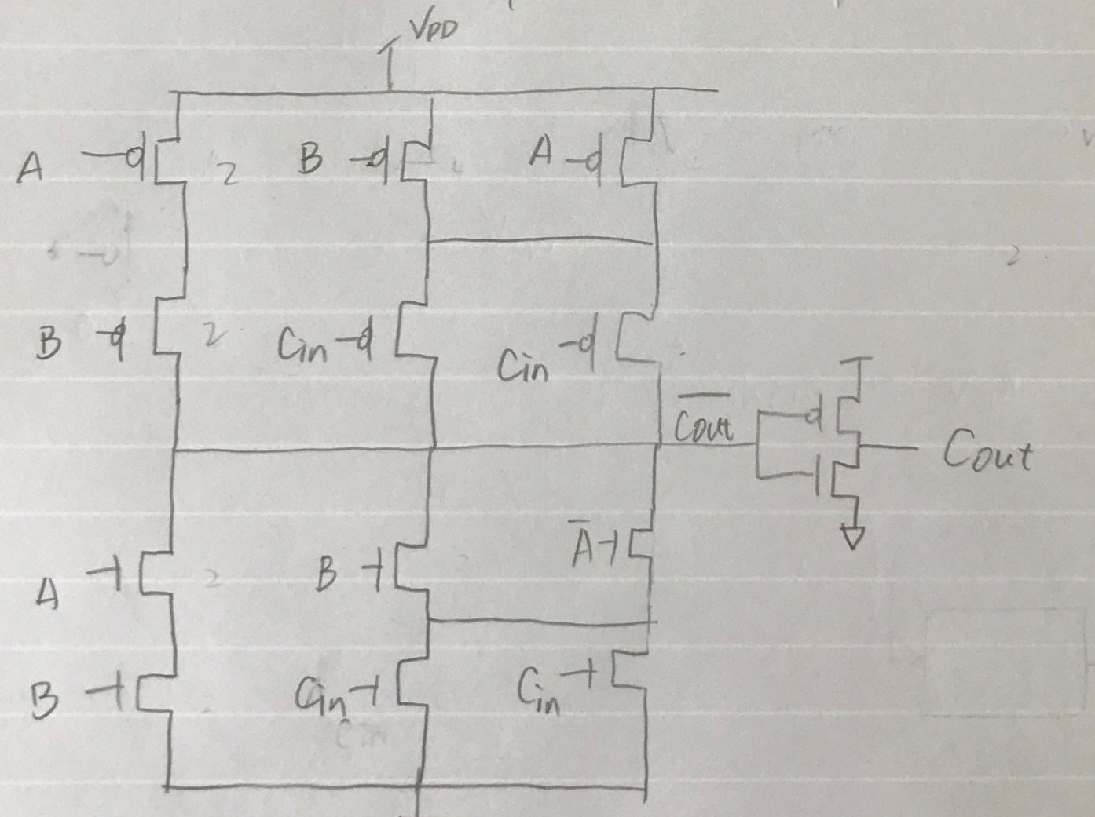
2017 hand-in example

Slide 25
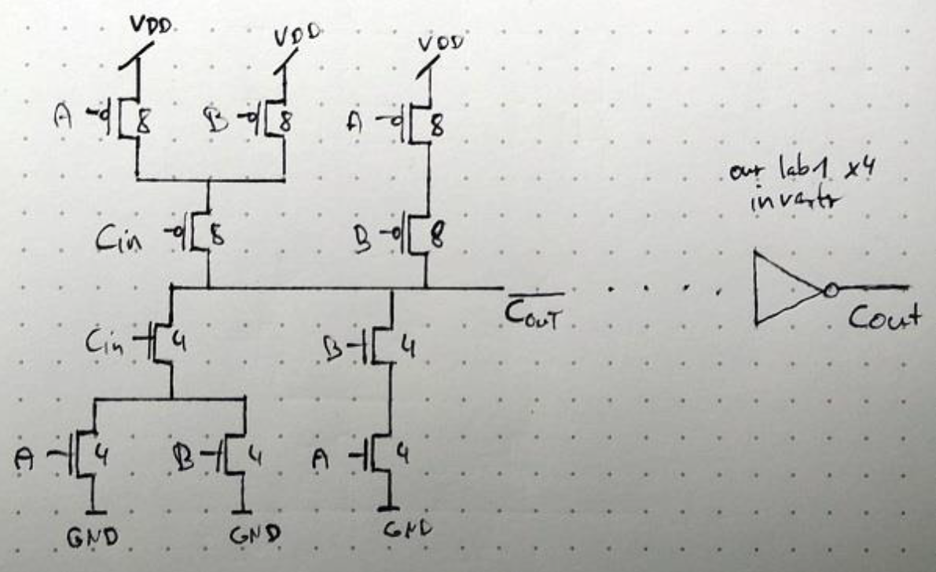
2017 hand-in example

Slide 26
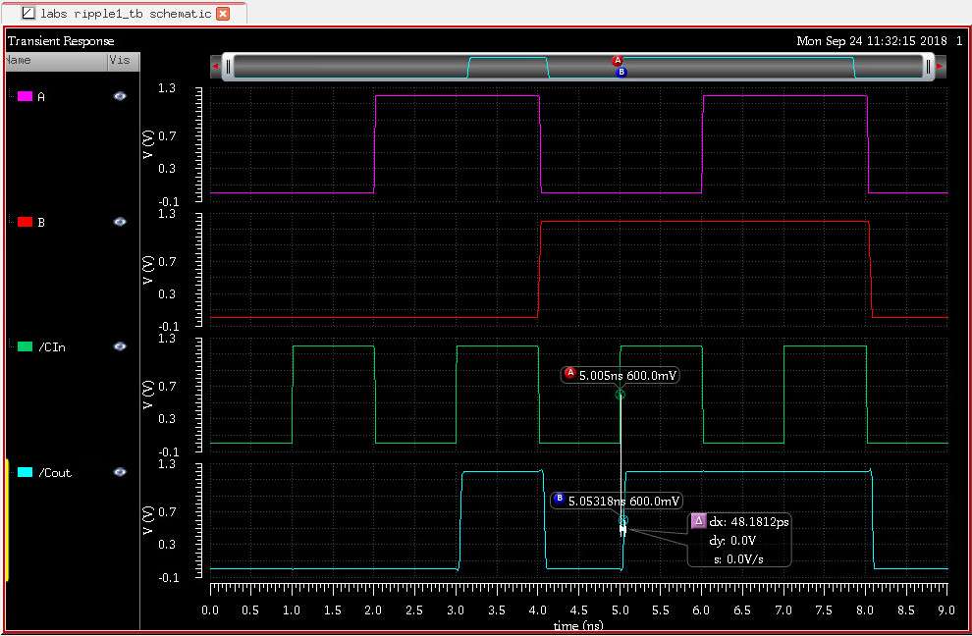

Slide 27
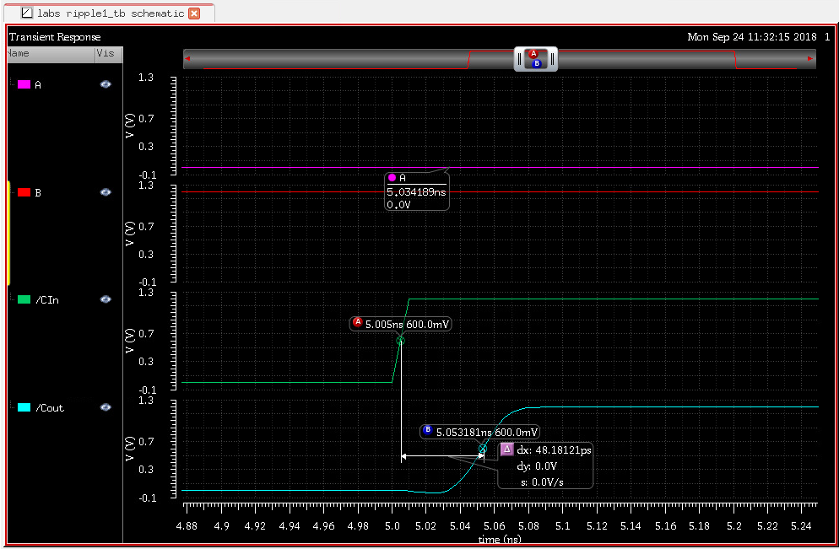

Slide 28
Simulating the carry cell Impact of test signals
A and B inputs:
B<0:7>= (1,1,1,1,1,1,1,1,)
A<0:7>=(In1,0,0,0,0,0,0,In7)
A
×
B
A
4
B
4
4
A
4
B
4
4
×
4
4
B
4
4
A
C
C
2
×
A
B
2
2
2
×
A
2
B
2
2
B
A
2
B
2
2
A
Expectation: fast
Expectation: slow

Slide 29
Simulated propagation delays TT models
Configuration | BAAB | ABBA | BABA | ABAB
Cin-Cout rise [ps] | 430 | 393 | 453 | 371
Cin-Cout fall [ps] | 446 | 453 | 488 | 413
Conclusion: Symmetrical schematics have less delay variation and the worst-case delay is shorter

Slide 30
Optimizing the size of the inverter
Logical effort g=2,
Parasitic delay p=4p_{inv}
VDD
Optimal path delay:
G = 2 × 1 = 2
H = C_{L}/C_{IN} =C_{IN}/C_{IN}= 1
F = 2 × 1 = 2
f_{opt} = √2
Sizing: Gate √2 larger than inverter
h_{gate} = 1/√2
h_{inv} = √2
A
4
B
4
4
A
Logical effort g=1,
Parasitic delay p=p_{inv}
4
4
B
C
2
2
A
A
2
B
2
2
B
VSS

Slide 31
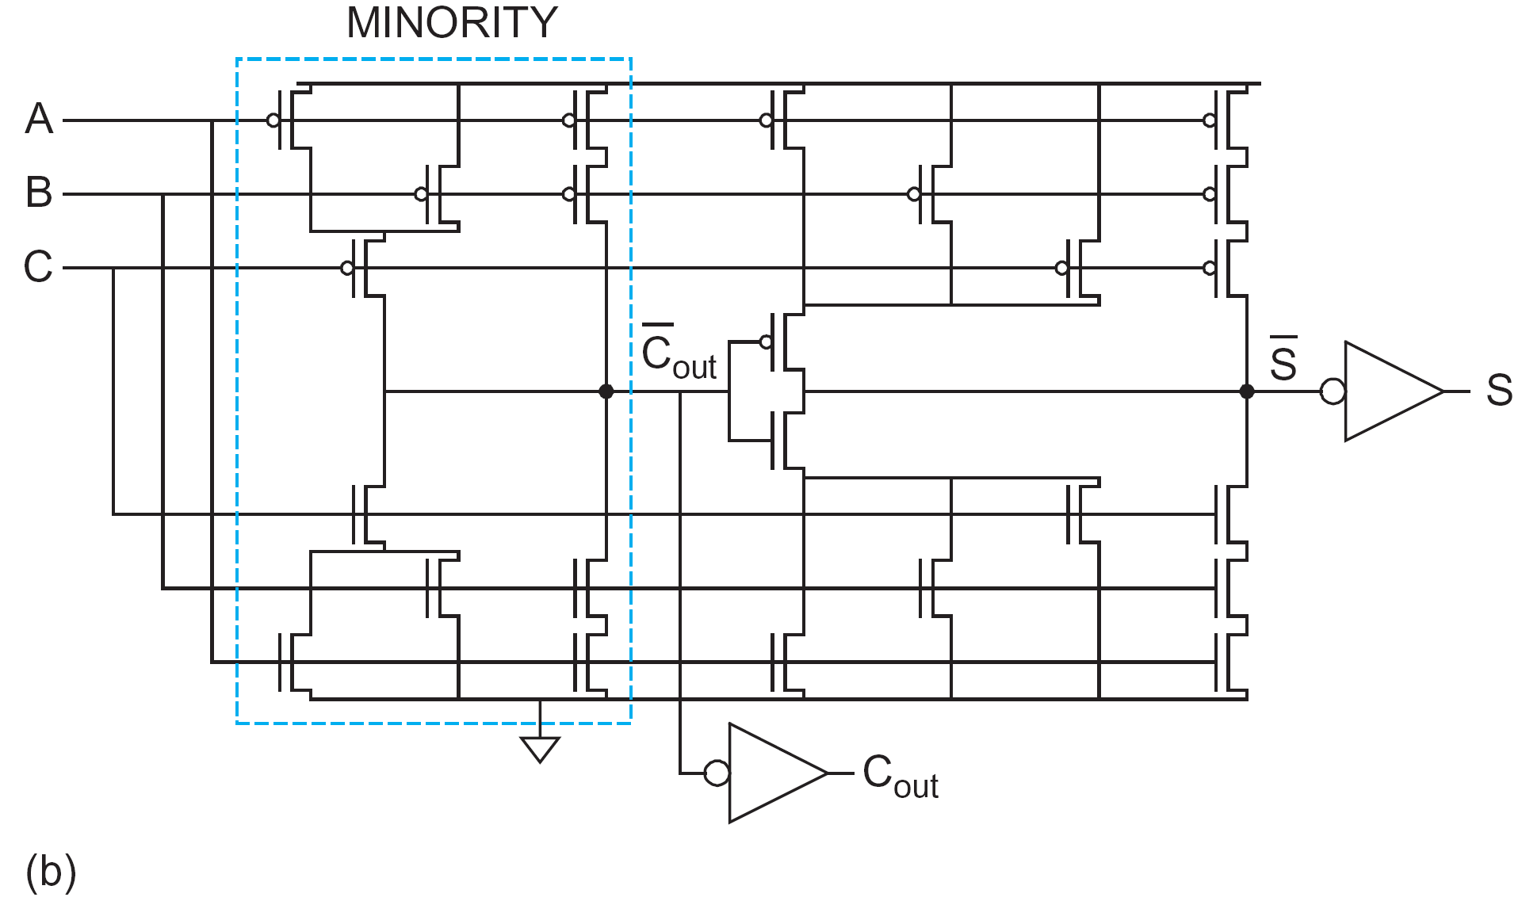
Textbook solution
a₀
b₀
X2 carry cell
X2 SUM cell
X2
Carry logic
c_{in}
X4
c_{out}
X4
a₀
X2
SUM logic
b₀
Sum₀
Design structure as proposed in textbook!
X4

Slide 32
Textbook solution
CARRY DELAY (CIN input)
d=4+2x(6+12)/6+1+(6+6+6)/12=4+6+1+1.5=12.5
X2 carry cell
X2 SUM cell
4
4
4
4
4
4
4
4
4
4
4
4
2
2
2
2
X4
2
2
2
2
2
2
2
2
CARRY LOGIC
(C input)
g=(2+4)/3=2
p=2x(2+4)/3=4
X4
8-bit adder delay: Consider also SUM cell load
d=8×(p+g×(2+4)/2+p_{inv}+3×2/4)≈8×(4+2×3+2.5)=100 → t_{pd}= 500 ps

Slide 33
Textbook solution
What if we resize MOSFETs in SUM cell for less load?
X2 carry cell
X1 SUM cell
4
4
4
2
2
4
2
2
4
2
2
2
1
2
1
1
2
2
2
1
1
2
1
1
CARRY LOGIC
(C input)
g=(2+4)/3=2
p=2x(2+4)/3=4
8-bit adder delay: Consider also SUM cell load
d=8×(4+2x(1+2)/2+1+(2+1+1))=8×(4+3+1)=8×10=80
→ t_{pd}= 400 ps
X2

Slide 34
Textbook solution
What if we resize MOSFETs in SUM cell?
X2 carry cell
X1 SUM cell
4
4
4
2
2
4
2
2
4
2
2
2
1
2
1
1
2
2
2
1
1
X
2
1
1
CARRY LOGIC
(C input)
g=(2+4)/3=2
p=2x(2+4)/3=4
X2
Which size is optimal? X2? X4?

Slide 35
Textbook solution
CARRY DELAY (CIN input)
What if we also resize the MOSFETs as shown in red, what is the parasitic delay, p, now?
X2
X1
4
2
2
2
2
4
2
2
4
2
2
2
1
2
1
1
2
1
1
1
1
2
1
1
CARRY LOGIC
(C input)
g=(2+4)/3=2
p=(2+4+2+1)/3=3
X2
CARRY DELAY (C input)
d=3+2x(1+2)/2+1+(2+1+1)/2=3+3+1+2= 9 units/stage
→ t_{pd}= 360 ps

Slide 36
What is the critical path for entire adder?
What happens at
the end of the
adder?

Slide 37
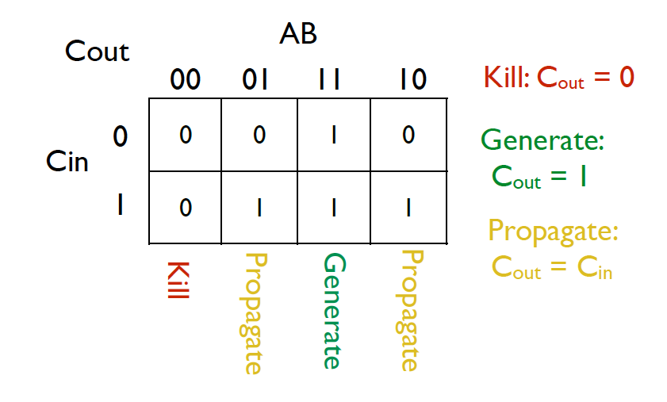
Precomputing from A and B simplifies carry (and sum) computing
Preview for week 6 & 7

Slide 38
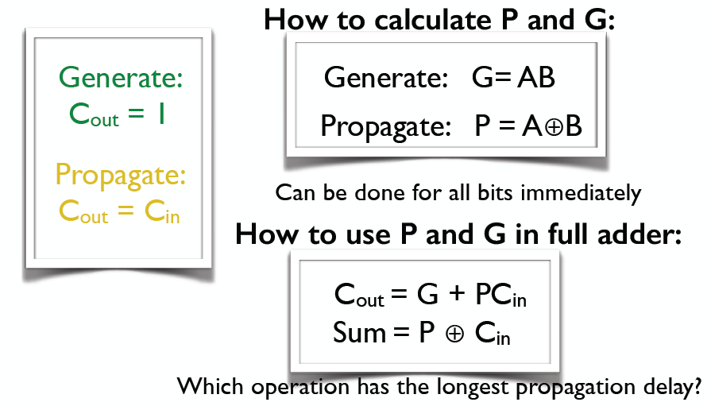
Precomputing from A and B simplifies carry (and sum) computing
Preview for week 6& 7

Slide 39
Conclusion
The test vectors matter.
What is the worst case?
Optimal sizing of inverter helps
Removing inverter entirely would be even better
Global optimization of critical path
Size down circuits not in critical path to limit their capacitive load
Precomputing “intermediate signals” from A and B also helps

Slide 40
Aim of the lecture
To give some basic understanding of intralayer and interlayer geometric design rules
Intralayer rules concerns minimum dimensions and spacing between objects in the same layer
Interlayer rules concerns minimum spacing and overlap rules between objects in two different layers:
MOSFET rules between poly and active
Contact and via rules between contacts or vias to their bottom and top contacting layers
Discuss the prelab assignment for the layout lab session

Slide 41
Why rules?
To minimize the risk of faulty circuits after fabrication.
Malfunction due to shorts
Improper forming of components or contacts
Electrical charging during fabrication.
More complex nowadays due to:
Smaller feature sizes
More complex fabrication processes
For example polishing for each metal layer

Slide 42
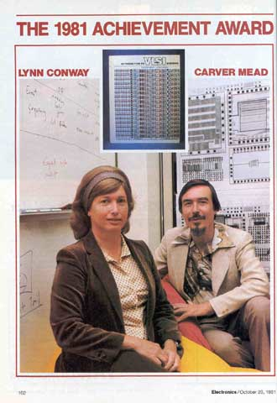
Who invented the simple (lambda) CMOS rules?
Carver Mead
Lynn Conway
http://ai.eecs.umich.edu/people/conway/Memoirs/VLSI/SSCM/VLSI_Reminiscences.pdf

Slide 43
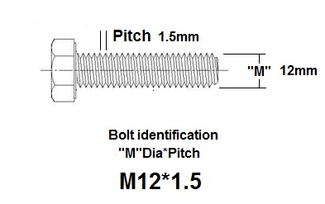
Geometric design rules
Interlayer rules
Active to poly
Intralayer rules
Interlayer rules
Contacts and vias
Pitch=W+S
Top layer extension
extension
extension
S
W
S
Bottom layer extension
pitch = width + separation

Slide 44
Geometric design rules
Intralayer rules
wide Metal 1
Metal 6-7
Metal 2-5
Metal 1
poly
diff
and parallell length >0.42
0.16
0.40
0.10
0.09
0.12
0.11
If W>0.42
0.40
0.10
0.09
0.11
0.06
0.08

Slide 45
Geometric design rules
Details of active/poly rules
Min width 0.40, min space 0.41
0.10
0.115
0.34
0.34
0.03
0.12
0.13
0.14
0.15 if
L>=0.09
P+ select

Slide 46
Geometric design rules
Contact and via* rules
*A via is a
contact
between two
metal layers.
No Poly_con
or poly bends
on active
0.11
0.10
0.07
0.055
0.11
*Min metal end 0.05

Slide 47
Geometric design rules
Contact and via rules
Diff_con
0.03
Poly_con
0.03
Also allowed
to enclose contact
with metal1 0.025
on all four sides.
0.09
0.09
0.04
0.04
0.04
0.04
For minimum width metal lines at least 0.04 enclosure is required on two opposite sides (bottom measures).
Via 1-4: 0.10x0.10
Via 5-6: 0.36x0.36
0.005**
**Met1 0.01
0.02
0.005
0.005*
0.05
0.05
0.08
0.08
At least two 0.05 metal ends on metal pad
At least two 0.08 metal ends on metal pad
0.34
(min 0.54 in array)

Slide 48
Detailed contacts
Diffusion contact
Poly contact
0.03
0.03
0.09
0.09
0.04
0.04
0.04
0.04
The contacts drawn here are the ones we recommend.
For minimum width metal lines (width = 0.09) at least 0.04 enclosure is required on two opposite sides, while on remaining two sides enclosure is 0.0.
Options:
It is also allowed to have metal1 enclose contact 0.025 in all four directions.
Diffusion rectangular: extension has to be 0.03 on two opposite sides and 0.015 on the two remaining sides.
Poly rectangular: extension has to be 0.04 on two opposite sides and 0.01 on the two remaining sides.

Slide 49
Geometric design rules
Standard cell template
with rails, n-well, pplus and nplus design rules
VDD
0.36
0.16
0.11
1.10
0.16
2.6
0.16
0.78
VSS
0.36

Slide 50
Prelab 3 assignment
Minimum metal extension beyond contact when minimum wire width is used
p-type
MOSFET
Poly Pitch 1
Poly Pitch 2
n-type
MOSFET
Poly pitch 3
Poly pitch 4
Min drain extension

Slide 51
Prelab 3 layout templates

Slide 52
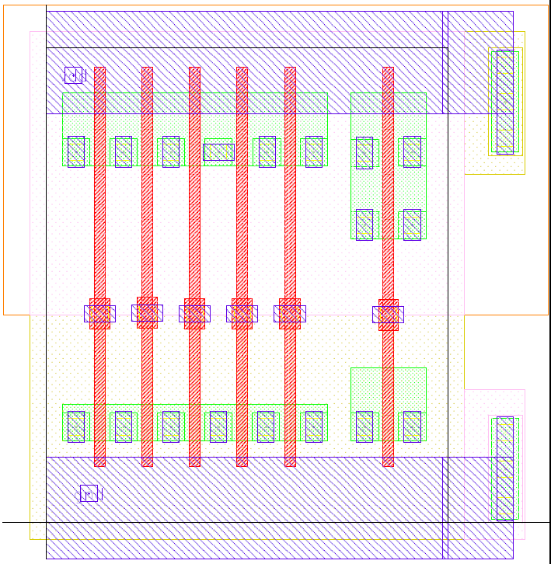
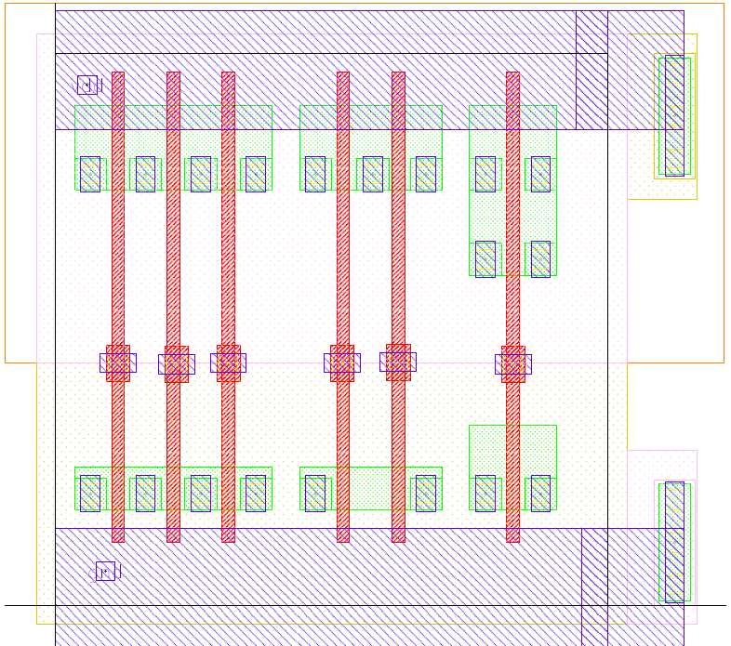
Prelab 3 layout templates

Slide 53
The layers
Physical layers in your layout:
N-well (NW)
Diffusion/Active (OD)
Poly (PO)
Metal-1 (M1)
Contact hole (CO)
Non-physical layers required in your layout:
P-select (PPLUS) (pink dots)
N-select (NPLUS) (yellow dots)

Slide 54
Example of layers

Slide 55
CMOS Layout
in
Well-mask
Active-mask
Shallow trench
Isolation (STI)
out
VSS
in
VDD
poly-mask
N⁺-select-mask
out
N⁺-diffusion
P⁺-select-mask
P⁺-diffusion
Body-ties
Field oxide
Contact-mask
p+
n+
n+
p+
p+
n+
Contact-etch
Metal-mask
VSS-contact
n-well
p-type silicon substrate
VDD-contact

Slide 56
Summary
In this lecture, we have
introduced intralayer and interlayer geometric design rules
defined the minimum pitch:
the sum of the minimum width and the minimum separation between two objects in the same layer
studied interlayer rules between objects in two different layers, like
MOSFET rules between poly and active
contact and via rules between contacts or vias to their bottom and top contacting layers
discussed the prelab assignment to the layout lab session

