Slide 1
Layout of CMOS gates

Slide 2
Week 4
Monday lab2
Carry gate schematic
Tuesday
Lecture Layout of CMOS gates
Thursday
Prelab lab 3, Geometrical design rules
Postlab review lab 2
Tutorial POTW Layout (Victor)
Friday Deadline prelab 3
Layout of carry ckt of full adder

Slide 3
From MUD cards
Path delay optimization complicated to understand.
Did not quite get the delay optimization example.
More simple examples before a more complex one.
Still confused to find out h, p.
In D=N × fopt + P, why is P sum of all parasitic delay?
Have the slides earlier before lecture? Not always possible, but the slides from last year are there.

Slide 4
Summary path delay optimization
Goal: minimize normalized path delay (that is, critical path delay)
Path effort F= G × H × B (general expression for all cases)
path electrical effort: H = C_{L}/C_{IN} (for entire path)
path branch effort: B = b₁ × ….. × b_{N} (for entire path)
path logical effort : G = g₁ × …..× g_{N} (for entire path)
Optimal stage effort is f_{opt} = ^{N}√F
Optimal path delay D_{opt} is then: D_{opt} = N × f_{opt} + P
where P is path parasitic delay = sum of all p in path
Read W&H section 4.5 Logical Effort of Paths

Slide 5
Clock tree task from latest exam
FIXED
FIXED
SCALABLE
SCALABLE
Find f_{opt}, D_{opt} and
the input capacitances at
stages 2 and 3
Work in small groups
Replies in socrative.com room: MCC0922018 as usual

Slide 6
Clock tree task from latest exam
First steps towards
solution:
F = G × B × H
F = (32/3)^2
Find f_{opt}, D_{opt} and
the input capacitances at
stages 2 and 3
Work in small groups
Replies in socrative.com room: MCC0922018 as usual

Slide 7
Clock tree task from latest exam
Solution:
f_{opt} = 32/3
D_{opt} = 38
(assuming p_{inv} = 1)
Find f_{opt}, D_{opt} and
the input capacitances at
stages 2 and 3
Work in small groups
Replies in socrative.com room: MCC0922018 as usual

Slide 8
Clock tree task from latest exam
Solution:
f_{opt} = 32/3
D_{opt} = 38
(assuming p_{inv} = 1)
Stage 3: C_{IN} =
(4/3)× 32C/(32/3) = 4C
Stage 2: C_{IN} =
(4/3) × (4Cx4)/(32/3) = 2C
Find f_{opt}, D_{opt} and
the input capacitances at
stages 2 and 3
Work in small groups
Replies in socrative.com room: MCC0922018 as usual

Slide 9
Improve delay by adding one inverter stage – how much is path delay improved?
FIXED
FIXED
SCALABLE
SCALABLE
SCALABLE
Find new
f_{opt}, D_{opt}
with added stage
Later you can calculate the sizes too
I will post those numbers

Slide 10
Improve delay by adding one inverter stage – how much is path delay improved?
Solution:
F =(32/3)^3
f_{opt} = 4√F≈ 5.9
D_{opt} = 4 × 5.9 + 7pinv =
30.6 (assuming p_{inv} = 1)
Find new
f_{opt}, D_{opt}
with added stage
Later you can calculate the sizes too
I will post those numbers

Slide 11
Improve delay by adding one inverter stage – how much is path delay improved?
Solution:
F =(32/3)^3
f_{opt} = 4√F≈ 5.9
D_{opt} = 4 × 5.9 + 7pinv =
30.6 (assuming p_{inv} = 1)
C_{IN2} = 5.9C
C_{IN3} = 6.5C
C_{IN4} = 7.2C
Find new
f_{opt}, D_{opt}
with added stage
Later you can calculate the sizes too
I will post those numbers

Slide 12
Aim of lecture
To give some basic understanding of layout trade-offs between wiring and transistors
To provide guidelines for systematic and structured design using standard cell templates
To discuss the influence of layout on performance
To use Euler paths to minimize parasitics and letting MOSFETs share common source/drain areas
To introduce methods for symbolic layout on virtual grids
Notes:
Why bother with physical design?

Slide 13
The inverter - - from schematic to layout
Inverter schematic
Inverter schematic
Power supply rails
Well tie
Active areas
Contacts to active areas
Contacts to poly gates
Metal wiring
Poly gates
Body ties
V_{DD}
V_{DD}
Poly only vertically
Metal mainly horizontally
How do we get through with metal wiring?
OUT
IN
IN
OUT
V_{SS}
V_{SS}
Substrate tie

Slide 14
The inverter - - from schematic to layout
Vertical poly straps
Well tie
V_{DD}
How do we get through with metal wiring?
IN
OUT
V_{SS}
Substrate tie

Slide 15
The inverter - - from schematic to layout
Active supply straps
Well tie
V_{DD}
How do we get through with metal wiring?
IN
OUT
V_{SS}
Substrate tie

Slide 16
The inverter - - from schematic to layout
Well tie
V_{DD}
WIRES ARE SHORTED!
Areas in the same layer connect if crossing or too close!
How do we get through with metal wiring?
IN
OUT
V_{SS}
Substrate tie

Slide 17
Inverter mask set and fabrication
P-type silicon substrate
P+ select
Poly gate
Contact cuts
Active areas
Metal wires
N-well
Notes:
From which direction do we see things?
The answers here are correct but there is a very important additional reason why a p-type substrate is preferred.
NMOS transistors are faster than PMOS transistors all else being equal. To make n channel MOS, the well must be p type. To get the maximum electron mobility, the p should be as lightly doped as practical. If an n type substrate were employed that would mean that the n channel MOS would be made with the addition of a p well. This p well would need to have a significantly higher doping than the n type substrate (each added dopant must be an order of magnitude higher than the background dopant). Now the p is higher than it needs to be for the n MOS.
Although most of the circuitry is CMOS (PMOS + NMOS gates), critical components that must run fast are exclusively NMOS. The fastest NMOS is obtained with a high resistivity p-type substrate, not a lower resistivity p-well in an n-type substrate.
The conventions came after this insight into performance.

Slide 18
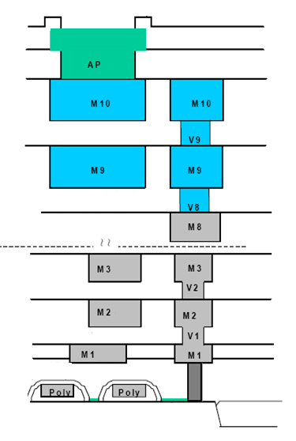
Above metal 1? A metal stack with many layers for wiring
Layers M2 and up
not used in cells.
Routed by tools.
Three types of wires:
Bottom/middle/top
Corresponds to wiring:
In cell/local/global
More about this next week!

Slide 19
Standard cell architecture
Fixed cell height: 2.6 um
Fixed supply rails
Fixed n-well regions
Fixed contact size and positions
VDD
A
2.6
B
VSS

Slide 20
Standard cell architecture
Fixed cell height: 2.6 um
Fixed supply rails
Fixed well
Fixed contact size and positions
But MOSFET widths can be change within limits for different inverter sizes (within limits).
For even wider inverters put transistors in parallel.
VDD
How many wire tracks can fit the empty space between the MOSFET source/drain contacts?
Pitch 1
A
Pitch 2
2.6
Pitch 3
B
Pitch 4
Extra space
A certain number of pitches are required, plus one extra space at bottom
VSS

Slide 21
Stick Diagrams
Stick diagrams help plan layout quickly
Need not be to scale
Draw with color pencils or dry-erase markers

Slide 22
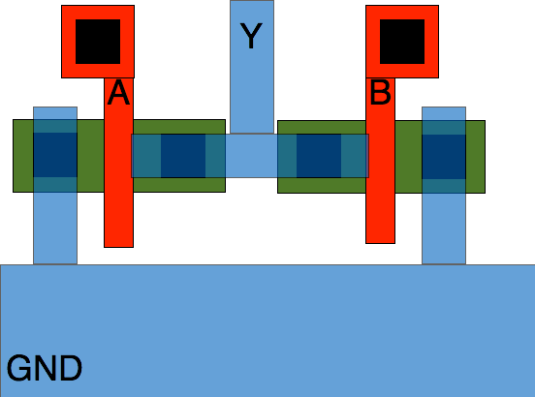
Merging drain areas example NOR2 n-net
A
B
Y
Notes:
I added some slides here because in my experience this is something some students find very hard to grasp.

Slide 23
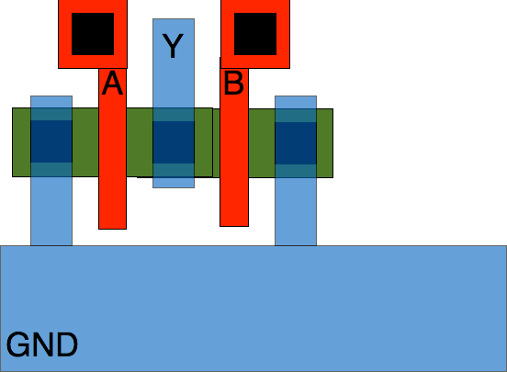
Merging drain areas example NOR2 n-net
A
B
Y
Notes:
Benefit?

Slide 24
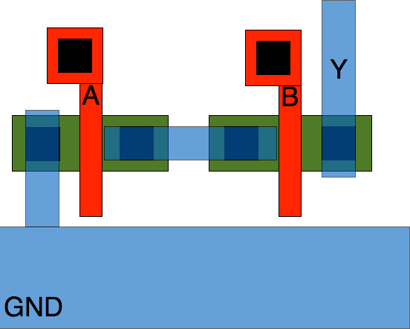
Merging drain areas example NAND2 n-net
Y
B
A

Slide 25
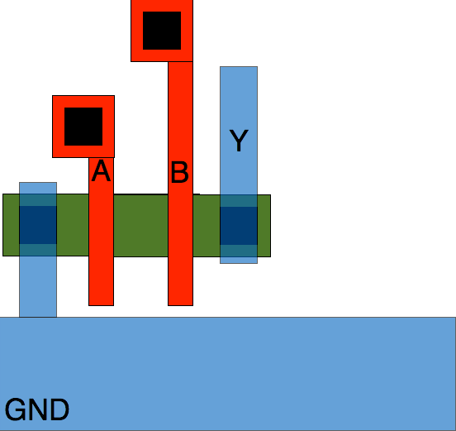
Merging drain areas example NAND2 n-net
Y
B
A
Notes:
And how does it look from the side? Draw on board!

Slide 26
The NAND2 gate
The NAND3 gate
V_{DD}
V_{DD}
out
ina
inb
ina
inb
inc
inc
out
out
out
inb
inb
ina
ina
V_{SS}
NAND2
NAND3
V_{SS}

Slide 27
The NOR3 gate
V_{DD}
V_{DD}
out
NOR3
ina
inb
ina
inb
inc
inc
NOR2
out
inb
inb
out
out
ina
ina
NOR2
NOR3
V_{SS}
V_{SS}

Slide 28
The AOI12 gate
V_{DD}
ina
inb
ina
inb
inc
out
out
ina
inc
inb
AOI12
V_{SS}
Notes:
Was this really the best solution?

Slide 29
The AO212 gate
V_{DD}
A
B
C
D
A
B
C
D
E
E
Z
A
D
E
B
C
V_{SS}

Slide 30
The AO212 gate
V_{DD}
A
B
C
D
A
B
C
D
E
E
Z
A
D
E
B
C
V_{SS}

Slide 31
Single line of diffusion
Goal: compact cell layout with as few extra contacts and metal-1 wires as possible.
That is: small area
That is: low parasitics at output and intermediate nodes.
Proxy: single line of diffusion
That is: draw the entire p/n diffusion without “lifting the pen”
Tool: Euler path

Slide 32
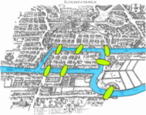
Graph theory: Euler paths
V_{DD}
V_{DD}
A
B
A
X
B
C
D
D
C
Z
V_{SS}
X
X
X
E
Z
A
D
E
E
B
C
V_{SS}
Z

Slide 33
Euler path
Graph consists of vertices (circuit nodes) connected by edges (transistors).
Euler path traverses every edge exactly once.
An Euler path exists if:
Exactly two or zero vertices have an odd degree.
If two vertices have an odd degree the path starts and ends in these vertices

Slide 34
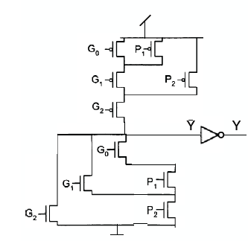
Example Euler paths
Is it possible to layout p-net, as drawn, with a single line of diffusion?
Is with it possible to layout n-net as drawn, with a single line of diffusion?
From exam 2017-10-26

Slide 35
Example with quiz
Draw the schematic for a static CMOS gate with the logical function:
f=(A∙B+C∙D)∙(E+F+G)
1 Can the p-net be laid out with single line of diffusion?
2 If yes, can you make the order ABCDEFG work?
3 Can the n-net be laid out with single line of diffusion?
4 If yes, can you make the order ABCDEFG work?
5 Is it possible to use single-line-of-diffusion layout for
both the n-net and the p-net at the same time?

Slide 36
Gate Matrix Layout
V_{DD}
P₀
C_{in}
C_{out}=G₃+P₃(G₂+P₂(G₁+P₁(G₀+P₀C_{in})
P₁
c_{out}
G₀
P₂
G₁
a₃
b₃
Set-up
cell
g₃
p₃
4-bit ripple-carry block
P₃
G₂
a₂
b₂
Set-up
cell
g₂
p₂
G₃
P₃
a₁
b₁
Set-up
cell
g₁
p₁
G₃
P₂
G₂
a₀
b₀
Set-up
cell
g₀
p₀
P₁
G₁
G₀
P₀
C_{in}
c_{in}
V_{SS}

Slide 37
Gate Matrix Layout
Our task in this example: We have been given the seemingly impossible task to layout the 4-bit ripple-carry block using the layout template given below, with the given gate order!!
Cin P1 G1 P2 G2 P3 G3 P4 G4
VDD
C_{IN}
C_{OUT}
VSS

Slide 38
Gate Matrix Layout
V_{DD}
G₂
C_{out}=G₃+P₃(G₂+P₂(G₁+P₁(G₀+P₀C_{in})
G₁
a₃
b₃
Set-up
cell
g₃
p₃
4-bit ripple-carry block
P₂
G₀
P₃
P₁
P₀
C_{in}
a₂
b₂
Set-up
cell
g₂
p₂
G₃
a₁
b₁
Set-up
cell
g₁
p₁
P₃
G₃
P₂
a₀
b₀
Set-up
cell
g₀
p₀
G₂
P₁
G₁
G₀
P₀
c_{in}
C_{in}
It seems impossible to pass all MOSFETs in the given order without passing some MOSFETs twice!
V_{SS}

Slide 39
Gate Matrix Layout
V_{DD}
G₂
C_{out}=G₃+P₃(G₂+P₂(G₁+P₁(G₀+P₀C_{in})
P₀
C_{in}
P₁
a₃
b₃
Set-up
cell
g₃
p₃
4-bit ripple-carry block
P₂
G₀
P₃
G₁
a₂
b₂
Set-up
cell
g₂
p₂
G₃
a₁
b₁
Set-up
cell
g₁
p₁
P₃
G₃
P₂
a₀
b₀
Set-up
cell
g₀
p₀
G₂
P₁
G₁
G₀
P₀
c_{in}
C_{in}
However, there is a solution! MOSFET blocks can be rearranged in the schematic with same functionality.
V_{SS}

Slide 40
Gate Matrix Layout
V_{DD}
G₂
C_{out}=G₃+P₃(G₂+P₂(G₁+P₁(G₀+P₀C_{in})
G₀
P₁
a₃
b₃
Set-up
cell
g₃
p₃
4-bit ripple-carry block
P₂
P₀
C_{in}
P₃
G₁
a₂
b₂
Set-up
cell
g₂
p₂
G₃
a₁
b₁
Set-up
cell
g₁
p₁
P₃
G₃
P₂
a₀
b₀
Set-up
cell
g₀
p₀
G₂
P₁
G₁
G₀
P₀
c_{in}
C_{in}
However, there is a solution! MOSFET blocks can be rearranged in the schematic with same functionality.
V_{SS}

Slide 41
Gate Matrix Layout
V_{DD}
G₂
C_{out}=G₃+P₃(G₂+P₂(G₁+P₁(G₀+P₀C_{in})
G₀
P₁
a₃
b₃
Set-up
cell
g₃
p₃
4-bit ripple-carry block
P₂
P₀
C_{in}
P₃
G₁
a₂
b₂
Set-up
cell
g₂
p₂
G₃
a₁
b₁
Set-up
cell
g₁
p₁
P₂
G₃
G₂
P₀
a₀
b₀
Set-up
cell
g₀
p₀
G₁
G₀
C_{in}
P₁
c_{in}
P₃
However, there is a solution! MOSFET blocks can be rearranged in the schematic with same functionality.
V_{SS}

Slide 42
Gate Matrix Layout
Here is the resulting layout!
Cin P1 G1 P2 G2 P3 G3 P4 G4
VDD
C_{IN}
C_{OUT}
VSS

Slide 43
Gate Matrix Layout
The layout again, a bit more refined!
Cin P1 G1 P2 G2 P3 G3 P4 G4
VDD
C_{IN}
C_{OUT}
VSS
The layout is very compact and elegant, however, only post-layout circuit simulations with node capacitances extracted from the layout will reveal the exact performance of the cell.

Slide 44
Example Layout
Complete the layout of this cell shown in the template in 3 where the n-net has already been completed. Note that for simplicity all transistors have the same widths in the template, although that may not be optimal.
Identify the five inputs and mark them clearly in the template. Then draw the required connections for the
p-net. Merge as many p-di usion areas as possible to simplify your layout.

Slide 45
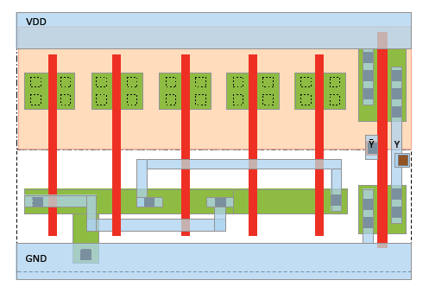
Example layout

Slide 46
Layout of the carry cell
VDD
A
B
A
B
C_{IN}
A
A
B
B
VSS

Slide 47
Layout of the carry cell

Slide 48
Connecting to a standard cell
Standard cell input/output ports can be placed anywhere in the cell
Router routes in higher metal layers to port
But there can be only one connection port per signal!
Lab 3 cells should be abutted
C_{in} input on the edge of one end
C_{out} output on the edge of other end
Treat A & B as if they can be connected anywhere in the cell.

Slide 49
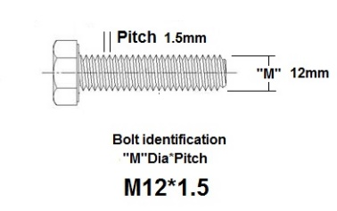
Design rules
We will talk about geometric design rules in more detail on Thursday, but . . .
. . . you probably need to know already now that there are intralayer rules and interlayer rules
Intralayer rules: width and spacing rules for each individual layer
Interlayer rules between layers
poly
Diff_con
0.03
poly
0.14
0.09
W
S
0.09
0.09
0.12
0.13
Poly_con
0.03
0.12
0.06
0.09
Pitch=W+S
Poly pitch on active=190 nm

Slide 50
General rules for CMOS layout
Run supply lines for VDD and VSS along the upper and lower cell boundaries
Run a vertical poly wire for each input signal
Order the poly wires to obtain maximal connectivity between transistors through abutment of source/drain areas. Connected transistors then form transistor segments.
Place n-transistor segments close to the bottom VSS supply rail and p-transistors close to the top VDD supply rail
Wires necessary to complete the design are drawn in metal, poly, or, if necessary in diffusion (for instance when connecting segments to the supply rails).
Remember to keep internal node capacitances at a minimum!

