Slide 1
Lecture 4
The CMOS Inverter
Dynamic properties

Slide 2
Week 2: The CMOS inverter
Tuesday
  Static properties
    Voltage transfer curves (VTC)
    Noise margins
  Exercise (Kjell, 1 hour)
Thursday
  Dynamic properties
    Propagation delay
    Driving large capacitive loads w. optimal propagation delay
  Exercise POTW (Victor, 2 hours)
Friday
  Prelab 1 deadline 1PM

Slide 3
Last time? Muddy?
How switching voltage is calculated
NOR/NAND gate VTC
Noise margins
  How calculate them
  Are they accurate from simplified models?
  Where does 1/8 come from in noise margin example?
  Butterfly diagram
C_{ox} what is that?

Slide 4
Voltage Transfer Characteristic - VTC
V_{OUT}
Inverter
V_{SW}
V_{DD}, V_{DD}
V_{DD}
NMOS OFF
PMOS OFF
V_{SW}
I_{DS}
V_{SW}
Switching means:
V_{IN}=V_{OUT}
I_{DS}
V_{IN}
V_{DD}
Switching occurs in the green region where both MOSFETs are saturated . . .
Saturation: I_{DSP,N}=I_{DSAT,P}
. . . and saturation currents are equal:
Solving for V_{IN} using x=k_{N}/k_{P} yields
V_{DS}

Slide 5

Noise margins

Slide 6
Noise Margins – an example
NMH=V_{OH,min}-V_{IH,min}
NML=V_{IL,max}- V_{OL,max}
Let´s define valid regions from points where slope A_{V} = -1!
NMH=V_{OH,min}-V_{IH,min}1.12-0.68=0.44 V
NML=V_{IL,max}- V_{OL,max} = 0.52-0.08=0.44 V
V_{OUT}
These points yields numbers for
(V_{OH,min}, V_{IL,max}) and
(V_{OL,max,} V_{IH,min})
so that NMH and NML can be calculated!
0.28 V
ΔV=0.64 V
0.28 V
V_{DD}
Valid ”1”
ΔV/8
V_{OH,min}
For x=1, V_{TN}=0.28 V and V_{TP}=-0.28 V we have V_{SW}=0.28+0.64/2=0.60 V
and ΔV=0.64 V
ΔV/8
ΔV/8
Formulas can be derived (for x=1):
V_{OH,min}=V_{DD}-ΔV/8
V_{OL,max} = ΔV/8
V_{IL,max}=V_{SW}-ΔV/8
V_{IH,min}=V_{SW}+ΔV/8
Formulas can be derived (for x=1):
V_{OH,min}=V_{DD}-ΔV/8=1.12 V
V_{OL,max} = ΔV/8=80 mV
V_{IL,max}=V_{SW}-ΔV/8=0.52 V
V_{IH,min}=V_{SW}+ΔV/8=0.68 V
V_{OL,max}
V_{DD} = 1.2 V
Valid ”0”
ΔV/8
0
V_{IN}
0
V_{IL,max}
V_{IH,min}
V_{DD}

Slide 7
Quick question
Have you tried solving prelab 3 yet?
Notes:
Take a few minuteson your own and then discuss with your neighbor.

Slide 8
Static vs dynamic
Last time: static (DC) behavior
Input: DC voltage,
Output: DC voltage
This time: dynamic behavior
That is, with time
Input: voltage waveform
Output voltage waveform
V_{DD}
V_{DD}
ON
ON
V_{IN}
V_{OUT}
V_{IN}
V_{OUT}
V_{IN}=0.2V
V_{OUT}=1.2V
C_{L}
OFF
OFF
In circuit simulation: DC analysis
In circuit simulation: transient analysis
Notes:
The load capacitor CL a placeholder.
Some current charges and discharges the load capacitance.

Slide 9
Outline
Definitions
  Rise time and fall time
  Propagation delay: Rise delay and fall delay
Propagation delay estimation
  Step response model
    Charging and discharging the load capacitor
  Ramp response model
    Introducing the MOSFET effective resistance
Inverter capacitances
  Model for scaled inverter: effective resistance and capactiance
Inverter pair delay
  Normalizing the inverter delay wrt τ=0.7RC
Delay w. more than one inverter
  Inverter pair delay
  The fanout-of-four (FO4) delay
  The tapered buffer, finding sizes and number of inverters
  (Buffers/drivers with branching)

Slide 10
Definitions for waveforms
V_{IN}
Input signal definitions: rise and fall times
100%
80%
Rising edge
Falling edge
20%
0
Time, t
t_{r}
t_{f}

Slide 11
Definitions for delay
V_{IN}
Propagation delay definitions: rise and fall delays
100%
Propagation delays are defined at the 50% level!
50%
0
Time, t
V_{OUT}
t_{pdf}
t_{pdr}
100%
50%
0
Time, t

Slide 12
Step-response model
V_{IN}
100%
50%
0
Time, t
V_{OUT}
t_{pdf}
t_{pdr}
100%
50%
0
Time, t
Output fall delay
Output rise delay

Slide 13
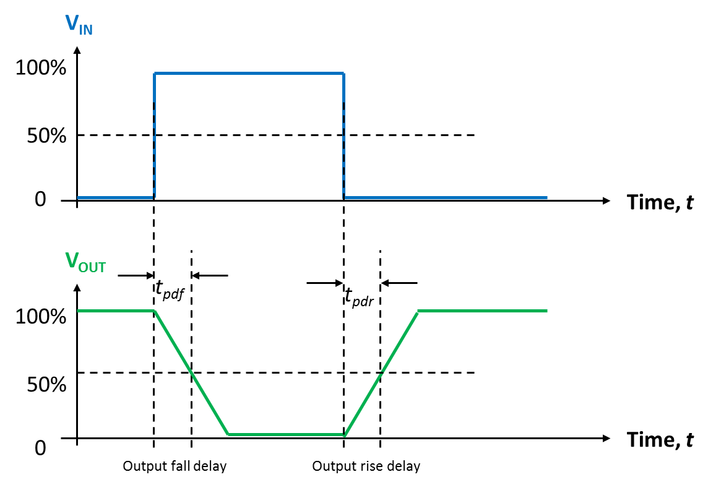
Step-response model
1. Charging the load capacitor through the p-channel MOSFET
V_{DD}
V_{IN} goes LOW
ON
V_{IN}
V_{OUT}
V_{IN}=LOW
C_{L}
OFF
V_{OUT} goes HIGH
I_{DS,P}
V_{SS}
I_{DSAT,P}
V_{OUT}
V_{DD}/2
V_{DD}
Output rise delay
pMOS current flow in detail
Notes:
Note that the xcharging current is constant!

Slide 14
Step-response model
2. Discharging the load capacitor through the n-channel MOSFET
V_{DD}
V_{IN} goes HIGH
OFF
V_{IN}
V_{OUT}
V_{IN}=HIGH
ON
C_{L}
V_{OUT} goes LOW
I_{DS,N}
V_{SS}
I_{DSAT,N}
V_{OUT}
V_{DD}/2
V_{DD}
Output fall delay
nMOS current flow in detail
Notes:
Note that the current is constant!

Slide 15
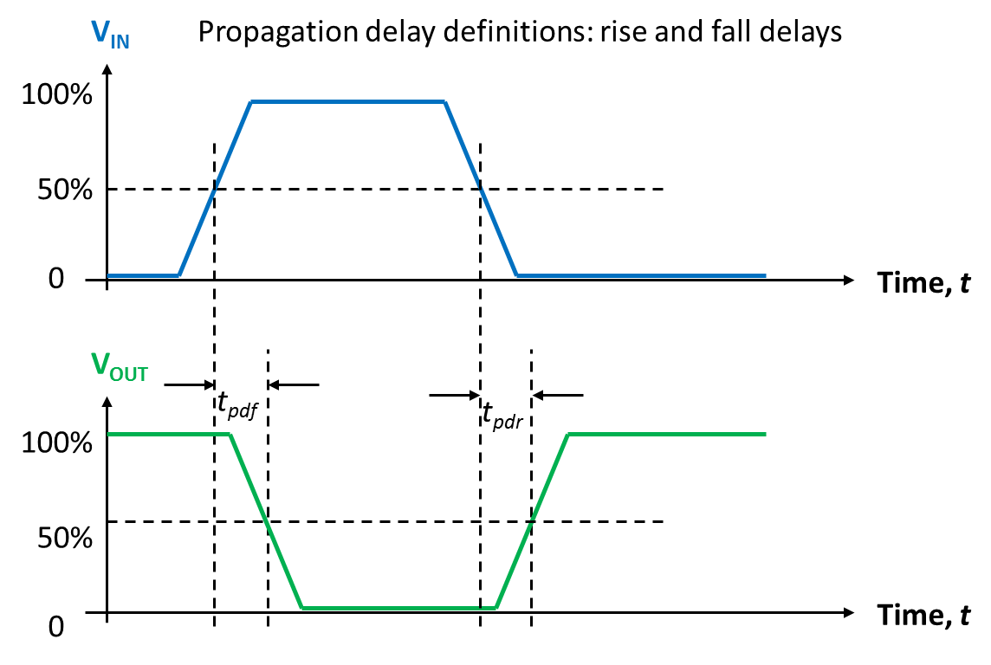
Step-response model accuracy
How good is the step-response model?
  Real world input voltages are not step functions
  They are output voltages from other gates

Slide 16
Step response model accuracy
Experience and hundreds of circuit simulations show that propagation delays are about 40% longer in designs where input and output edge rates are equal
Notes:
We add another 40% to match.

Slide 17
The most important equation

Slide 18
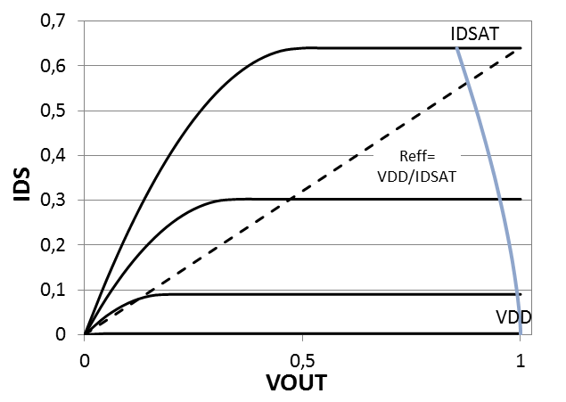
Ramp input – output trace
V_{IN}:
V_{GS} rises from 0 to V_{DD}
V_{GS} = V_{DD}
V_{GS} = 0
Some discharge happens while input rises from 0 to VDD
Most discharge still happens with IDSAT,max

Slide 19
Effective resistances: 65 nm MOSFETs
R_{N,eff}=2 kΩ.μm
R_{P,eff}=4 kΩ.μm
I_{DS}
N-channel device
I_{DS}
P-channel device
I_{DSAT,max} =
600 μA/μm
I_{DSAT,max} =
300 μA/μm
R_{eff}=V_{DD}/I_{DSAT,max}
R_{eff}=V_{DD}/I_{DSAT,max}
V_{DS}
V_{DS}
V_{DD}=1.2 V
V_{DD}
V_{DD}=1.2 V
V_{DD}
Notes:
Note that a wider transistor give more current, that is less effective resistance.
Note that Reff has no fixed relation to GON which depends on the threshold voltage.
SO I = Reff x Vout

Slide 20
The most important equation revisited
Notes:
About the 0.7 factor – it is annoying but we have to live with it….

Slide 21
RC delay
This RC circuit has an output voltage delay given by
R_{eff}
V_{OUT}
V_{DD}
C_{L}
V_{SS}

Slide 22
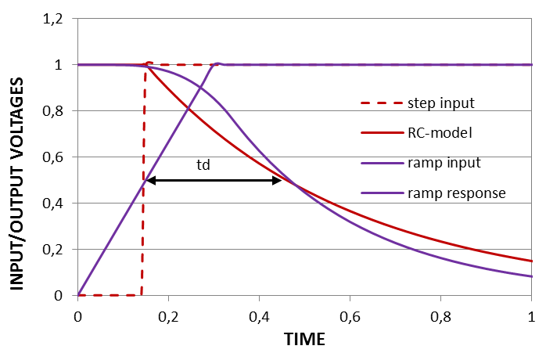
Ramp input – output response
The two curve forms are not the same, but they yield the same delay!
Notes:
The curves are not the same but they coincide at the important 50 % point. The effect of the ramped response is correct there. The 0.7 factor helps here.
The purple curve is slower at the beginning because current is not so large yet.

Slide 23
MOSFET capacitances
(from lecture 2)
There is a distributed gate capacitance that must be lumped to to the available ckt nodes, that is, source and drain
There are parasitic capacitances from source/drain to substrate
L_{S}
L_{D}
C_{sidewall}
C_{sidewall}
Metal gate
source
drain
STI
L
STI
W, the channel width
C_{bottom}
C_{bottom}
Silicon substrate
L, the channel length
Notes:
This is where Cox can be viewed. Cox is the capacitance per area of the gate-channel

Slide 24
65 nm CMOS capacitances
Gate capacitance
Plate capacitance between gate and channel (but here we model it between gate and source)
C_{G}=WLC_{ox}
C_{ox}≈20 fF/μm²
(corresponds to 1.2 nm effective oxide thickness, t_{ox})
60 nm effective channel length yields:
C_{G}=1.2 fF/μm
Drain/source parasitic capacitances
Same order of magnitude as the gate capacitance, C_{S}=C_{D}=p_{inv}C_{G}
Generic approach is to use p_{inv}=1 for simplicity
But sometimes p_{inv}=0.5 or p_{inv}=0.8!
L_{D}
W
channel
length, L
L_{S}
Notes:
Minimum LD and Ls are given by design rules as we will see in week 4.

Slide 25
Electrical model for saturated MOSFET
(from lecture 2)
V_{G}
V_{D}
C_{G}
I_{DSAT}
C_{D}
V_{S}
V_{S}
Model for saturated MOSFET
Valid for both nMOS and pMOS transistors
Notes:
Model has been slightly updated so that it is correct also for pMOSFETs

Slide 26
The inverter and its electrical model
Replace the MOSFETs with their equivalent electrical circuits!
V_{DD}
C_{GP}
I_{DSP}
C_{DP}
PMOS
V_{IN}
V_{OUT}
V_{DD}
V_{DD}
V_{IN}
V_{OUT}
NMOS
C_{GN}
I_{DSN}
I_{DSN}
C_{DN}
V_{SS}
V_{SS}
V_{SS}

Slide 27
The inverter and its electrical model
Change the sign of the pMOS current so that all currents are positive
(We also made the pMOS voltages positive, although it is not necessary)
V_{DD}
C_{GP}
I_{SDP}
C_{DP}
PMOS
V_{IN}
V_{OUT}
V_{DD}
V_{DD}
V_{IN}
V_{OUT}
NMOS
C_{GN}
I_{DSN}
I_{DSN}
C_{DN}
V_{SS}
V_{SS}
V_{SS}

Slide 28
The inverter and its electrical model
Place all capacitors to signal ground! Both rails are constant voltages, no dV/dt
V_{DD}
V_{DD}
V_{DD}
I_{SDP}
V_{IN}
V_{OUT}
V_{IN}
V_{OUT}
C_{G}=C_{GN}+C_{GP}
I_{DSN}
I_{DSN}
C_{D}=C_{DN}+C_{DP}
V_{SS}
V_{SS}
V_{SS}
Inverter input capacitance: C_{G}=C_{GN}+C_{GP}; MOSFET gate capacitances add!
Inverter parasitic output capacitance: C_{D}=C_{DN}+C_{DP}. Drain caps also add!

Slide 29
The inverter and its electrical model
Eliminate VDD rail by inserting power supply to signal ground!
V_{DD}
V_{IN}
V_{OUT}
V_{IN}
V_{OUT}
C_{G}=C_{GN}+C_{GP}
I_{SDP}
I_{DSN}
C_{D}=C_{DN}+C_{DP}
V_{DD}
V_{SS}
V_{SS}
V_{SS}
Inverter input capacitance: C_{G}=C_{GN}+C_{GP}; MOSFET gate capacitances add!
Inverter parasitic output capacitance: C_{D}=C_{DN}+C_{DP}. Drain caps also add!

Slide 30
The inverter and its electrical model
Replace MOSFET constant-current sources with their effective resistances!
V_{DD}
R_{N,eff}=2 kΩ.μm
R_{P,eff}=4 kΩ.μm
V_{IN}
V_{OUT}
V_{IN}
V_{OUT}
C_{G}=C_{GN}+C_{GP}
R_{P,eff}
R_{N,eff}
C_{D}=C_{DN}+C_{DP}
V_{DD}
V_{SS}
V_{SS}
V_{SS}
Inverter input capacitance: C_{G}=C_{GN}+C_{GP}; MOSFET gate capacitances add!
Inverter parasitic output capacitance: C_{D}=C_{DN}+C_{DP}. Drain caps also add!

Slide 31
The inverter and its electrical model
Too cumbersome to have different rise and fall delays!
Replace effective resistances with one average effective resistance!
V_{DD}
R_{N,eff}=2 kΩ.μm
R_{P,eff}=4 kΩ.μm
W=1
R_{eff}=3 kΩ.μm
V_{IN}
V_{OUT}
V_{IN}
V_{OUT}
W=1
C_{G}=C_{GN}+C_{GP}
V_{DD}
C_{D}=C_{DN}+C_{DP}
V_{SS}
V_{SS}
V_{SS}
Inverter input capacitance: C_{G}=C_{GN}+C_{GP}; MOSFET gate capacitances add!
Inverter parasitic output capacitance: C_{D}=C_{DN}+C_{DP}. Drain caps also add!

Slide 32
The inverter and its electrical model
Too cumbersome to have different rise and fall delays!
Replace effective resistances with one average effective resistance!
V_{DD}
Or even better!
Design the inverter for equal effective resistances, R_{P,eff}=R_{N,eff}, by making p-channel MOSFET twice as wide as the n-channel MOSFET to compensate for the lower hole mobility
W=2
R_{N,eff}=2 kΩ.μm
V_{IN}
V_{OUT}
V_{IN}
V_{OUT}
W=1
C_{G}=C_{GN}+C_{GP}
V_{DD}
C_{D}=C_{DN}+C_{DP}
V_{SS}
V_{SS}
V_{SS}
Inverter input capacitance: C_{G}=C_{GN}+C_{GP}; MOSFET gate capacitances add!
Inverter parasitic output capacitance: C_{D}=C_{DN}+C_{DP}. Drain caps also add!

Slide 33
Inverter capacitances
V_{DD}
Task: Calculate C_{G} and C_{D} with pMOS FET is twice as wide as nMOS FET expressed in the width of the nMOS transistor.
W=2
R_{N,eff}=2 kΩ.μm
V_{IN}
V_{OUT}
V_{IN}
V_{OUT}
W=1
C_{G}=3.6 fF/μm
V_{DD}
C_{D}=p_{inv}C_{G}
V_{SS}
V_{SS}
V_{SS}
We notice that C_{G} × R_{N,eff} is a constant. It will soon return!
Answer: Assuming L=60 nm and C_{ox}=20 fF/μm² we obtain C_{GN}=1.2 fF/μm and C_{GP}=2.4 fF/μm. Hence C_{G}=3.6 fF/μm.
Concerning C_{D} we assume C_{D}=p_{inv}C_{G}=3.6 fF/μm with p_{inv}=1.
Notes:
So it the total transistor width (p+n) is 1 um
Answer: Assuming L=60 nm and C_{ox}=20 fF/μm² we obtain C_{GN}=1.2 fF/υm and C_{GP}=2.4 fF/υm. Hence C_{G}=3.6 fF/υm.
Concerning C_{D} we assume C_{D}=p_{inv}C_{G}=3.6 fF/μm with p_{inv}=1.

Slide 34
More than one inverter

Slide 35
Inverter pair delay
Task: Calculate the inverter pair delay!
V_{DD}
R_{eff}

Slide 36
Inverter pair delay
Put on your “two-port glasses” and look towards the loading inverter!
You will only see the input capacitance of the loading inverter
V_{DD}
R_{eff}
C_{G}

Slide 37
Inverter pair delay
Have your “two-port glasses” on and look towards the driving inverter!
You will see a voltage source with a certain source resistance, and you will see the parasitic capacitance of the loading inverter
V_{DD}
R_{eff}
C_{D}
C_{D}

Slide 38
Inverter pair delay
In an ideal inverter the time constant tau is really what the name says, a constant;
It is independent of inverter size (as long as W_{P}/W_{N}=2).
V_{DD}
R_{eff}
C_{D}
C_{G}
Propagation delay:
All delay calculations are made wrt to this technology time constant tau (𝜏)

Slide 39
Inverter pair delay
Equivalent electrical circuit for propagation delay calculations
V_{DD}
R_{eff}
V_{OUT}
C_{D}
C_{G}
Propagation delay:
All delay calculations are made wrt to this technology time constant tau (𝜏)

Slide 40
Important concept
The technology time constant tau, 𝜏:

Slide 41
Quiz time!
  Go to socrative.com
  Select Student login
  Go to room: “MCC0922018”

Slide 42
Inverter FO4 delay
One inverter drives 4 identical inverters
X1
C_{G}
X1
V_{DD}
X1
C_{G}
X1
R_{eff}
C_{G}
X1
C_{D}
C_{G}
The FO4 propagation delay in our 65 nm process:
Notes:
We will motivate why this is important

Slide 43
Normalized FO4 delay
X1
C_{G}
X1
V_{DD}
X1
C_{G}
X1
R_{eff}
C_{D}
C_{G}
X1
C_{G}
Normalized delay means normalized to 𝜏
So FO4 normalized delay:

Slide 44
Important concept
The normalized delay, d:
Where tau, 𝜏, is the technology time constant, 𝜏

Slide 45
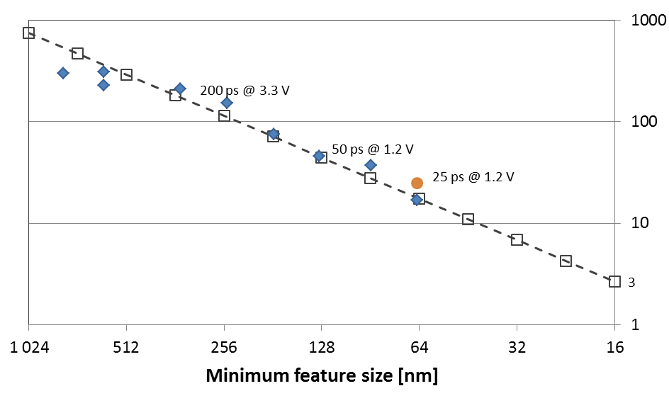
FO4 delay trends vs. feature size
1 μm
0.5 μm
1/4 μm
0.13 μm
65 nm
32 nm
22 nm

Slide 46
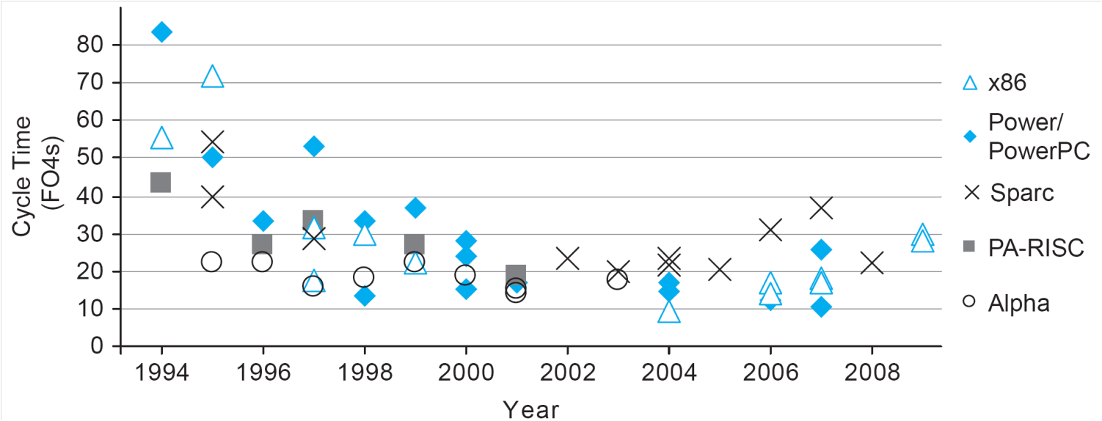
Microprocessor cycle time trends
From Weste & Harris.

Slide 47
Inverter Size
In most vendor cell libraries, inverters and other logic gates come in a number of different varieties concerning their driving capability (R_{eff}) and input capacitance (C_{G}).
In the following all inverters and logic gates of a certain size, e.g. size X=8, will have the same input capacitance, and, as an example, this input capacitance will be only half the input capacitance of a gate of size X=16.
Notes:
For inverters this is not a bproblem, for other gates it can be more confusing.

Slide 48
Minimizing delay through multiple inverters

Slide 49
Path definitions
H is the
path electrical effort
C
x₁C
x₂C
C_{L}=HC
R_{eff}
R_{eff}/x₁
R_{eff}/x₂
Path electrical effort: H = C_{L}/C_{IN}
Stage electrical effort or fanout for inverter n: h_{n} = C_{INn+1}/C_{INn} = x_{n+1}/x_{n}
Normalized delay for inverter n: d_{n} = h_{n} + p_{inv}
Normalized path delay with N stages : D = N × p_{inv} + h₁ + h₂ + … + h_{N}
Notes:
These concepts will come lack next Thursday.

Slide 50
The tapered buffer with 3 stages
Reference inverter . . .
and two inserted buffer inverters
Size=1
Size x₁
Size x₂
H is the
path electrical effort
C
x₁C
x₂C
C_{L}=HC
R_{eff}
R_{eff}/x₁
R_{eff}/x₂
Normalized path delay: D = 3 p_{inv} + h₁ + h₂ + h₃ where h₁=x₁, h₂=x₂/x₁ and h₃=H/x₂.
But only h₁ and h₂ are independent variables, h₃ becomes h₃=H/h₁h₂:
D = 3 p_{inv} + h₁ + h₂+ H/h₁h₂
Show that minimum delay is obtained for h₁=h₂=³√H, which gives:
D_{min} = 3 p_{inv} + 3 × ³√H

Slide 51
The tapered buffer with 3 stages
Example with path
electrical effort H=64
Reference inverter . . .
and two inserted buffer inverters
Size=1
Size x₁ = 4
Size x₂ = 16
C
4C
16C
C_{L}=64C
R_{eff}
R_{eff}/4
R_{eff}/16
Normalized path delay: D = 3 p_{inv} + h₁ + h₂ + h₃ where h₁=x₁, h₂=x₂/x₁ and h₃=H/x₂.
But only h₁ and h₂ are independent variables, h₃ becomes h₃=H/h₁h₂:
D = 3 p_{inv} + h₁ + h₂+ H/h₁h₂
Example: H = 64
Minimum delay is obtained for h₁=h₂=³√64=4 gives D = 3(p_{inv}+4)=15 with p_{inv}=1

Slide 52
The tapered buffer with N stages
What if the path electrical effort, for some reason, is very large, e.g. H=4096.
How many inverters, N, are needed to minimize the delay?
Size=1
Large path electrical
effort H=4096=2¹²
C
C_{L}=HC
Minimum path delay D=N(p_{inv}+h)? Determine best N and h!

Slide 53
Best h & N?
Optimal h with p_{inv}=0 can be shown analytically to be h=e= 2.72 for N_{opt} = ln(H)
With larger p_{inv} numerical solution gives h≈4
  That is why the FO4 delay is so important!
The minimum is, so a bit larger h does only increase delay marginally and substancially smaller area

Slide 54
Quick question
If you were to design a tapered buffer where the load capacitance is 1500 times larger than the input capacitance, and you are not allowed to invert the signal, how many inverters would you choose?
What would be the resulting normalized delay for the buffer?

Slide 55
H-tree clock distribution

Slide 56
H-tree clock distribution
What is the timing path electrical effort?
What sizes to choose for inverters in the H-tree?

Slide 57
Short summary
The inverter propagation delay, with effective resistance
The technology time constant, tau
The normalized delay
Normalized inverter pair delay
Normalized fanout-of-four ( FO4) delay
Tapered buffer with path fanout H and N stages (D is normalized path delay)
Optimal h is around 4

Slide 58
Long summary
Defined rise and fall delays at the 50% level (V_{DD}/2) andrise and fall times between 20% and 80% levels
Calculated propagation delay in response to a square-wave input signal assuming MOSFETs being saturated during delay
Improved the delay model by adding 40%
  assuming a ramp input signal and
  assuming equal input and output edge rates
Replaced saturation current sources by effective resistances
Made the pMOSFET twice as wide to compensate for lower hole mobility
  Both MOSFETs now have the same effective resistance of 2 kΩ.μm
  However, p-channel device now has twice the input capacitance of the n-channel MOSFET
Obtained an electrical two-port model of the inverter for delay calculations
  we know what this model looks like seen from the input port, and seen from the output port
Calculated the FO4 delay, and we found the R_{eff}C_{G} product being independent of the inverter size (as long as we keep same ratio between W_{P} and W_{N})
Introduced technology time constant, tau, and normalized delay, d
Found best inverter sizes of a tapered inverter buffer for minimum delay. Fanout h = 4 is the optimum.

