Slide 1
The CMOS Inverter
Lecture 3
Static properties
= voltage transfer curves (VTC)
and noise margins

Slide 2
Week 2: The CMOS inverter
Tuesday
  Static properties
    Voltage transfer curves (VTC)
    Noise margins
  Exercise (Kjell, 1 hour)
Thursday
  Dynamic properties
    Propagation delay
    Driving large capacitive loads w. optimal propagation delay
  Exercise POTW (Victor, 2 hours)
Friday
  Prelab 1 deadline 1PM

Slide 3
What happened last week?
Let’s do a quiz about the transistor:
  Go to socrative.com
  Select Student login
  Go to room: “MCC0922018”
Notes:
Take a few minuteson your own and then discuss with your neighbor.

Slide 4
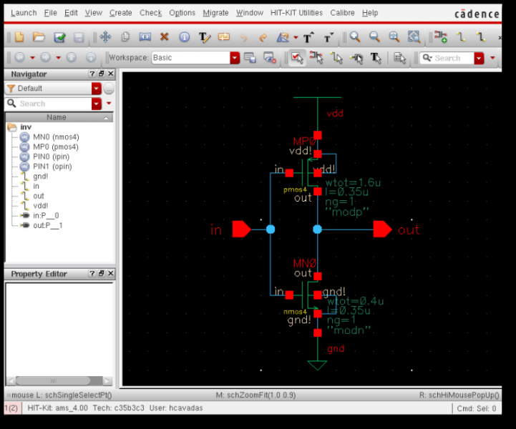
Where are we?
Inverter
Logic gates
P
P-type pull-up network
IN
OUT
IN
OUT
N
N-type
Pull-down
network
Designing w switches
Hands-on lab session

Slide 5
Where are we?
Inverter
Logic gates
P-type pull-up network
1
0
IN
OUT
N-type
Pull-down
network
Designing w switches
Hands-on lab session

Slide 6
Where are we?
Inverter
Logic gates
P-type pull-up network
0
1
IN
OUT
N-type
Pull-down
network
Designing w switches
Hands-on lab session

Slide 7
Where are we?
Inverter
Logic gates
P-type pull-up network
V_{SW}
I_{DS}
V_{SW}
IN
OUT
N-type
Pull-down
network
Designing w switches
Hands-on lab session

Slide 8
MOSFET I/V Characteristics
I_{DS}
ON
Saturation: I_{DSN}=I_{DSAT,N}
I_{DSN}=G_{ON}V_{DS}
V_{DS}
OFF: I_{DS}=0
OFF: I_{DS}=0
I_{DSP}=G_{ON}V_{DS}
Saturation: I_{DSP}=I_{DSAT,P}
ON

Slide 9
MOSFET I/V Characteristics
I_{DS}
ON
Saturation: I_{DSN}=I_{DSAT,N}
Saturation: I_{SDP}=I_{DSAT,P}
ON
I_{SDP}=G_{ON}V_{SD}
I_{DSN}=G_{ON}V_{DS}
V_{DS}
OFF: I_{DS}=0
OFF: I_{DS}=0

Slide 10
MOSFET I/V Characteristics
I_{DS}
ON
Saturation: I_{DSN}=I_{DSAT,N}
Saturation: I_{DSP}=I_{DSAT,P}
I_{DSN}=G_{ON}V_{DS}
V_{DS}
OFF: I_{DS}=0

Slide 11
V_{IN}/V_{OUT} voltage plane
V_{OUT}
V_{DD}, V_{DD}
V_{DD}
NMOS OFF
NMOS
V_{IN}
PMOS
PMOS OFF
V_{DD}

Slide 12
V_{IN}/V_{OUT} voltage plane
V_{OUT}
V_{DD}, V_{DD}
V_{DD}
NMOS OFF
PMOS OFF
V_{IN}
V_{DD}

Slide 13
Voltage Transfer Characteristic - VTC
V_{OUT}
Inverter
V_{DD}, V_{DD}
V_{DD}
NMOS OFF
PMOS OFF
I_{DS,P}=0
0
1
I_{DS,N}=0
I_{DS}
V_{IN}
V_{DD}
The ON p-switch pulls the output high
V_{DS}

Slide 14
Voltage Transfer Characteristic - VTC
V_{OUT}
Inverter
V_{DD}, V_{DD}
V_{DD}
NMOS OFF
PMOS OFF
I_{DS,P}=0
1
0
I_{DS,N}=0
I_{DS}
V_{IN}
V_{DD}
The ON n-switch pulls the output low
V_{DS}

Slide 15
An aside about MOSFET current equations
Shockley’s continuous model:
Our piecewise linear model:

Slide 16
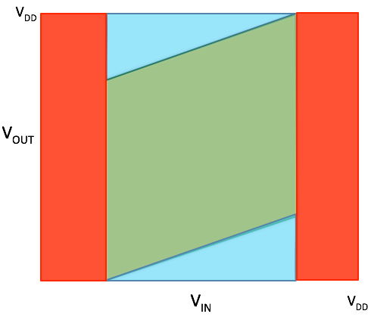
So with piecewise linear MOS model the inverter diagram is this:
Notice
different slopes
between green
and blue regions!
Transition voltage is
VGT/2 rather than VGT

Slide 17
Voltage Transfer Characteristic - VTC
V_{OUT}
Inverter
V_{DD}, V_{DD}
V_{DD}
NMOS OFF
PMOS OFF
V_{SW}
I_{DS}
V_{SW}
I_{DS}
V_{IN}
V_{DD}
The ON n-switch pulls the output low
V_{DS}

Slide 18
Voltage Transfer Characteristic - VTC
V_{OUT}
Inverter
V_{SW}
V_{DD}, V_{DD}
V_{DD}
NMOS OFF
PMOS OFF
V_{SW}
I_{DS}
V_{SW}
Switching means:
V_{IN}=V_{OUT}
I_{DS}
V_{IN}
V_{DD}
Switching occurs in the green region where both MOSFETs are saturated . . .
Saturation: I_{DSP,N}=I_{DSAT,P}
. . . and saturation currents are equal:
Solving for V_{IN} using x=k_{N}/k_{P} yields
V_{DS}

Slide 19
Voltage Transfer Characteristic - VTC
V_{OUT}
ΔV
Inverter
V_{SW}
V_{DD}
NMOS OFF
PMOS OFF
V_{SW}
I_{DS}
V_{SW}
I_{DS}
V_{IN}
V_{DD}
The switching voltage equation
can be rewritten on a form easier to grasp if we introduce
Saturation: I_{DSP,N}=I_{DSAT,P}
V_{DS}

Slide 20
Voltage Transfer Characteristic - VTC
V_{OUT}
Inverter
V_{SW}
V_{DD}, V_{DD}
V_{DD}
NMOS OFF
PMOS OFF
V_{SW}
I_{DS}
V_{SW}
I_{DS}
V_{IN}
V_{DD}
Equal currents in top blue region where p-MOSFET is in linear region
yields V_{OUT} vs. V_{IN!}
V_{DS}

Slide 21
Voltage Transfer Characteristic - VTC
V_{OUT}
Inverter
V_{SW}
V_{DD}, V_{DD}
V_{DD}
NMOS OFF
PMOS OFF
V_{SW}
I_{DS}
V_{SW}
I_{DS}
V_{IN}
V_{DD}
Equal currents in bottom blue region where n-MOSFET is linear region
yields V_{OUT} vs. V_{IN!}
V_{DS}

Slide 22
The voltage characteristic (VTC)
For x=k_{N}/k_{P}=1 we have
What if we make n-channel MOSFET wider, i.e. for x>1?
V_{OUT}
V_{DD}
What happens to VTC?
Will switching voltage V_{SW} increase or decrease?
Assume x=4 and we have
Assume x=1/4 and we have
0
V_{IN}
0
V_{TN}
V_{SW}
V_{DD}+V_{TP}
V_{DD}

Slide 23
The voltage characteristic (VTC)
Which VTC is NAND and which VTC is NOR?
Assume all transistor same width
V_{OUT}
V_{DD}
NAND
NOR
0
V_{IN}
0
V_{TN}
V_{SW}
V_{DD}+V_{TP}
V_{DD}

Slide 24
The voltage characteristic (VTC)
How about current flow?
No current flow in red regions!
”short-circuit” current I_{SC} flows in blue/green regions
V_{OUT}
n-channel MOSFET saturated for V_{IN}<V_{SW}
V_{DD}
p-channel MOSFET saturated
for V_{IN}>V_{SW}
0
V_{IN}
0
V_{TN}
V_{SW}
V_{DD}+V_{TP}
V_{DD}
Notes:
Current is important because it increases power consumption. The slower an inverter switches, the longer it will be in the green region => more current will flow. Week 6.
What should you expect in the lab? How does a “real” inverter curve look different from our idealized

Slide 25

Noise margins
What are they?
Why are they important?
Answers the question: How much noise can the circuit tolerate?
Notes:
Any ideas about what noise can be and where is can come from?

Slide 26
Noise Margins - preliminairies
V_{OUT}
Let´s define valid input and output voltage regions from points where slope of VTC is -1;
That is where A_{V} = -1!
A_{V} is the voltage gain.
V_{DD}
V_{OH,min}
Valid ”1”
V_{OL,max}
Valid ”0”
0
0
V_{IL,max}
V_{IH,min}
V_{DD}
V_{IN}
Notes:
You could have another definition, but this is the most common one

Slide 27
Noise margins - NMH
V_{OUT}
V_{DD}
V_{IN}
Valid ”1”
V_{DD}
V_{OH,min}
NMH
V_{IN} not valid
Valid ”0”
V_{IH,min}
Valid ”1”
V_{IL,max}
V_{OL,max}
Valid ”0”
0
V_{IL,max}
V_{IH,min}
V_{IN}
V_{OUT}
Notes:
For the noise margin calculation our piecewise-linear model is not good enough?

Slide 28
Noise Margins- NML
V_{OUT}
V_{DD}
V_{IN}
Valid ”1”
V_{DD}
V_{OH,min}
V_{IN} not valid
V_{IH,min}
Valid ”1”
V_{IL,max}
NML
V_{OL,max}
Valid ”0”
0
0
V_{IL,max}
V_{IH,min}
V_{IN}
V_{OUT}

Slide 29
Regenerative effect
= How well the signal is regenerated from input to output
f(V_{IN})
Consider a pair of cross-coupled inverters
V_{IN}
V_{OUT}
that is
g(V_{OUT})
We take the partial derivate of this function w.r.t V_{IN} (using the chain rule):
Slopes, that is, small-signal gains
So we see that the inverse of f (the VTC) is g in each pair of corresponding voltage points.
Only if the VTC has a region of gain magnitude > 1 bordered by two regions of
gain magnitude < 1 is the circuit regenerative. Then there are two stable operating points.
The VTC and its inverse are illustrated in the butterfly diagram.

Slide 30
Butterfly Diagram
In each pair of corresponding voltage points (V_{IN}, V_{OUT}) the product of the
derivatives (that is the small-signal gains) of the two curves is 1
The points where both gains are -1 defines the voltages of interest for noise margins
V_{OUT}
V_{DD}
Valid ”1”
V_{OH,min}
Memory cell characterization
NMH
V_{IN}
V_{OUT}
VTC, that is f
NML
Inverse of VTC, that is g
See W&H section 12.2.1.3
for more info if you want to.
V_{OL,max}
Valid ”0”
0
0
V_{IL,max}
V_{IH,min}
V_{IN}

Slide 31

Noise Margins – skewed inverters
NMH
NML
NML
NMH

Slide 32
Noise Margins – an example
Let´s define valid regions from points where slope A_{V} = -1!
NMH=V_{OH,min}-V_{IH,min}
NML=V_{IL,max}- V_{OL,max}
V_{OUT}
These points yields numbers for
(V_{OH,min}, V_{IL,max}) and
(V_{OL,max,} V_{IH,min})
so that NMH and NML can be calculated!
V_{DD}
Valid ”1”
V_{OH,min}
V_{OL,max}
Valid ”0”
0
V_{IN}
0
V_{IL,max}
V_{IH,min}
V_{DD}

Slide 33
Noise Margins – an example
NMH=V_{OH,min}-V_{IH,min}
NML=V_{IL,max}- V_{OL,max}
Let´s define valid regions from points where slope A_{V} = -1!
NMH=V_{OH,min}-V_{IH,min}1.12-0.68=0.44 V
NML=V_{IL,max}- V_{OL,max} = 0.52-0.08=0.44 V
V_{OUT}
These points yields numbers for
(V_{OH,min}, V_{IL,max}) and
(V_{OL,max,} V_{IH,min})
so that NMH and NML can be calculated!
0.28 V
ΔV=0.64 V
0.28 V
V_{DD}
Valid ”1”
ΔV/8
V_{OH,min}
For x=1, V_{TN}=0.28 V and V_{TP}=-0.28 V we have V_{SW}=0.28+0.64/2=0.60 V
and ΔV=0.64 V
ΔV/8
ΔV/8
Formulas can be derived (for x=1):
V_{OH,min}=V_{DD}-ΔV/8
V_{OL,max} = ΔV/8
V_{IL,max}=V_{SW}-ΔV/8
V_{IH,min}=V_{SW}+ΔV/8
Formulas can be derived (for x=1):
V_{OH,min}=V_{DD}-ΔV/8=1.12 V
V_{OL,max} = ΔV/8=80 mV
V_{IL,max}=V_{SW}-ΔV/8=0.52 V
V_{IH,min}=V_{SW}+ΔV/8=0.68 V
V_{OL,max}
V_{DD} = 1.2 V
Valid ”0”
ΔV/8
0
V_{IN}
0
V_{IL,max}
V_{IH,min}
V_{DD}

Slide 34
What about lab 1
Calculate VSW and find from simulation in lab
Calculate noise margins and find from simulation

Slide 35
Summary
CMOS inverter – schematic
Voltage transfer characteristics (VTC)
  Regions of operation
  How to calculate switching voltage V_{SW}
  V_{SW} dependence on k_{N}/k_{P} (that is, transistor widths)
  Understand switching current (I_{SC}) flow
Noise margins: NMH and NML
  Why important?
  Definition
  Butterfly diagram

Slide 36
Why not n-switches in pull-up networks?
Initial value before switch is turned ON: V_{OUT}=0
Register cell
V_{DD}
Adder
cell
Logic “one”
V_{IN}
p-switch
V_{OUT}
V_{DD}
I_{DS}
Equivalent circuit:
V_{DD}
V_{OUT}
GND
V_{OUT}
V_{DD}
V_{OUT}=V_{DD}-V_{TN}

Slide 37
Why not p-switches in pull-down networks?
Initial value before switch is turned ON: V_{OUT}=V_{DD}
Register cell
V_{DD}
Adder
cell
Logic “zero”
V_{IN}
p-switch
V_{OUT}
V_{DD}
I_{DS}
Equivalent circuit:
V_{OUT}
V_{SS}
GND
V_{OUT}
V_{DD}
V_{OUT}=-V_{TP}

