Slide 1
Lecture 15
Introduction to Integrated Circuit Design
What if . . . optimizations
Notes:
In this first lecture of the introductory course in integrated circuit design, we are going to learn how to design CMOS logical gates with a certain functionality.
But first, let me just say a few words on the context where we will meet combinational logic in a design.

Slide 2
Optimization – Introduction
Function to
be optimized
y
Arbitrary units
x
x_{opt}
Input variable

Slide 3
Inverter pair delay
Question: What if we want to minimize the inverter pair delay, how should we choose the width of the p-channel device wrt the width of the n-channel device - considering the difference in electron and hole mobility?
Answer: Assume R_{P}=μR_{N} for the same channel widths. Typically μ=2
Rise delay:
V_{DD}
V_{DD}
Fall delay:
V_{IN}
V_{IN}
Normalized pair delay :
C_{N}
V_{SS}
V_{SS}
Minimum pair delay for:

Slide 4
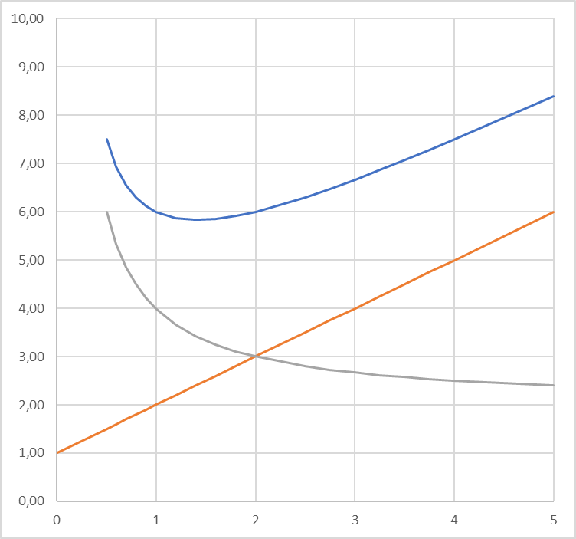
Inverter pair delay
Question: What if we want to minimize the inverter pair delay, how should we choose the width of the p-channel device wrt the width of the n-channel device - considering the difference in electron and hole mobility?
Answer: Assume R_{P}=μR_{N} for the same channel widths. Typically μ=2
Rise delay:
Fall delay:
Normalized pair delay :
Minimum pair delay for:

Slide 5
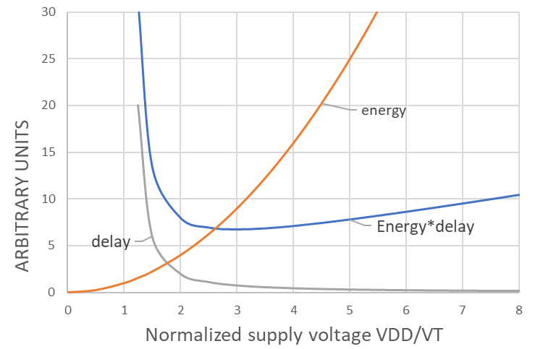

Optimization – Energy*delay product
Question: What if we want to minimize the energy-delay product. How should we choose V_{DD} wrt to V_{T}?
Answer: It should be three times larger, i.e.
Energy:
Delay:
Energy*delay product
$$\text{has} \text{a} \text{minimum} \text{for} V_{DD}=3V_{T}$$

Slide 6
Optimal tapering factor
Standard inverter
N -1 inverters in buffer
C
pC
fC
pfC
f²C
pf²C
f³C
pf³C
R
R/f
R/f²
R/f³
C_{L}=xC
In total N inverters
Relative delay=number of stages * stage delay:
Minimum delay when all inverters have the same fanout:
Number of stages:
Relative delay:

Slide 7
Optimal tapering factor
5
e
Delay
1
Area
0
Parasitic delay, p
3
0
TAPERING FACTOR, f
8
For typical values of p, the optimum tapering factor is between 3.6 and 5. Typically a FO4!
A buffer with N-1 extra inverters consume an area A₀ ≈ f + f² + ... + f^{N-1}
By choosing a somewhat larger tapering factor we can easily save more than 50% in area while only losing 10% in speed!
[From Hedenstierna & Jeppson 1987]

Slide 8
Optimization – Number of inputs
Question: What if we were to build a 16-bit AND gate using n-input NAND/ NOR-gate combinations, what would be the most efficient number of gate inputs to minimize the delay? (Reminder: )
Answer: Is it with 2- or 4-input gates? Or with 8-input gates?
2-input NAND-NOR gates
4-input NAND-NOR gates
16-bit AND gate
16-bit AND gate

Slide 9
Optimization – Number of inputs
Question: What if we were to build a 16-bit AND gate using n-input NAND/ NOR-gate combinations, what would be the most efficient number of gate inputs to minimize the delay? (Reminder: )
Answer: Is it with 2- or 4-input gates? Or with 8-input gates?
The NAND/NOR pair delay can be written d_{pair}=3m+1.
With a logical depth, N, given by n^{N}=16, the total normalized delay can be written
AB
CD
&
≥1
Y
&
which has a minimum for
However, the number of inputs must in this case be a multiple of 2, so our choice is to use 2- or 4-input gates; both resulting in about the same delay, with a minor advantage for the 4-input solution.

Slide 10
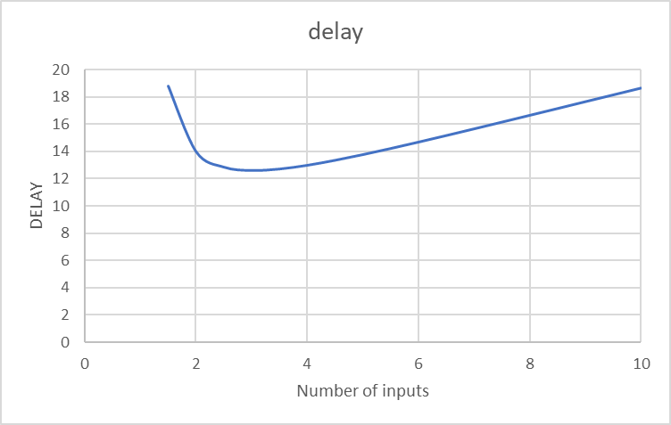
Optimization – Number of inputs
Question: What if we were to build a 16-bit AND gate using n-input NAND/ NOR-gate combinations, what would be the most efficient number of gate inputs to minimize the delay? (Reminder: )
Answer: Is it with 2- or 4-input gates? Or with 8-input gates?
The NAND/NOR pair delay can be written d_{pair}=3m+1.
With a logical depth, N, given by n^{N}=16, the total normalized delay can be written
which has a minimum for
However, the number of inputs must in this case be a multiple of 2, so our choice is to use 2- or 4-input gates; both resulting in about the same delay, with a minor advantage for the 4-input solution.

Slide 11
Driving long wires
driver inverter
driver inverter
receiver inverter
receiver inverter
R_{W}
R
R_{w}, C_{w}
X120
X120
X120
p_{inv}C
C_{W}/2
C_{W}/2
C
Wire π-model
1. Start by defining wire effort
2. Replace wire with wire RC π-model!
3. Consider critical wire length for repeater insertion!
where r and c are wire resistance and capacitance per unit length!

Slide 12
Repeater insertion
driver inverter
receiver inverter
X120
R_{w}/m, C_{w}/m
X120
R_{w}/m, C_{w}/m
X120
driver model
R_{W} /m
receiver model
driver model
R_{W} /m
receiver model
R
C
R
C
p_{inv}C
C_{W}/2m
C_{W}/2m
C
p_{inv}C
C_{W}/2m
C_{W}/2m
C
Wire π-model
Wire π-model
Normalized delay m segments
Find minimum
Find minimum

Slide 13
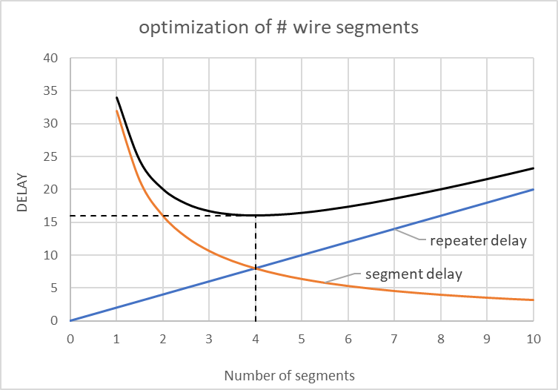
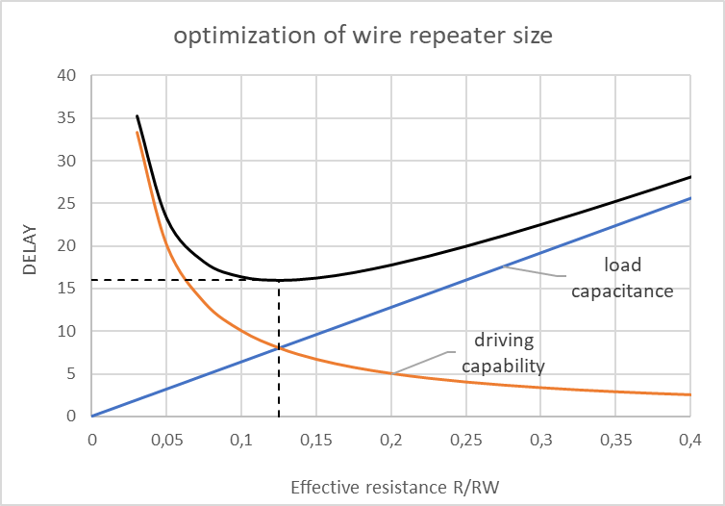
Repeater insertion
driver inverter
receiver inverter
X120
R_{w}/m, C_{w}/m
X120
R_{w}/m, C_{w}/m
X120
Minimum delay when all four delay terms are equal! Minimum normalized delay is d=4√W_{E}.

Slide 14
32-bit carry skip adder
Identify worst-case propagation delay for 32-bit adder!
How to optimize a 32-bit adder built with k n-bit blocks?
a_{32:25} b_{32:25}
a_{24:17} b_{24:17}
a_{16:9} b_{16:9}
a_{8:1} b_{8:1}
ADD/SUB logic
Bit P, G
ADD/SUB logic
Bit P, G
ADD/SUB logic
Bit P, G
ADD/SUB logic
Bit P, G
P_{32:25}
P_{24:17}
P_{16:9}
P_{8:1}
c_{out}
1
0
+
1
0
+
1
0
+
1
0
+
c_{in}
Sum_{32:25}
Sum_{24:17}
Sum_{16:9}
Sum_{8:1}
The worst case delay, t_{skip}, is for calculating the most significant bit sum when a carry is generated in the least significant bit.

Slide 15
32-bit carry skip adder
Identify worst-case propagation delay for 32-bit adder!
How to optimize a 32-bit adder built with k n-bit blocks?
a_{32:25} b_{32:25}
a_{24:17} b_{24:17}
a_{16:9} b_{16:9}
a_{8:1} b_{8:1}
ADD/SUB logic
Bit P, G
ADD/SUB logic
Bit P, G
ADD/SUB logic
Bit P, G
ADD/SUB logic
Bit P, G
t_{pg}
P_{32:25}
P_{24:17}
P_{16:9}
P_{8:1}
c_{out}
1
0
+
1
0
+
1
0
+
1
0
+
c_{in}
Sum_{32:25}
Sum_{24:17}
Sum_{16:9}
Sum_{8:1}
The worst case delay, t_{skip}, is for calculating the most significant bit sum when a carry is generated in the least significant bit.

Slide 16
32-bit carry skip adder
Identify worst-case propagation delay for 32-bit adder!
How to optimize a 32-bit adder built with k n-bit blocks?
a_{32:25} b_{32:25}
a_{24:17} b_{24:17}
a_{16:9} b_{16:9}
a_{8:1} b_{8:1}
ADD/SUB logic
Bit P, G
ADD/SUB logic
Bit P, G
ADD/SUB logic
Bit P, G
ADD/SUB logic
Bit P, G
t_{pg}
P_{32:25}
P_{24:17}
P_{16:9}
P_{8:1}
c_{out}
1
0
+
1
0
+
1
0
+
1
0
+
c_{in}
Sum_{32:25}
Sum_{24:17}
Sum_{16:9}
Sum_{8:1}

Slide 17
32-bit carry skip adder
Identify worst-case propagation delay for 32-bit adder!
How to optimize a 32-bit adder built with k n-bit blocks?
a_{32:25} b_{32:25}
a_{24:17} b_{24:17}
a_{16:9} b_{16:9}
a_{8:1} b_{8:1}
ADD/SUB logic
Bit P, G
ADD/SUB logic
Bit P, G
ADD/SUB logic
Bit P, G
ADD/SUB logic
Bit P, G
t_{pg}
P_{32:25}
P_{24:17}
P_{16:9}
P_{8:1}
c_{out}
1
0
+
1
0
+
1
0
+
1
0
+
c_{in}
Sum_{32:25}
Sum_{24:17}
Sum_{16:9}
Sum_{8:1}

Slide 18
32-bit carry skip adder
Identify worst-case propagation delay for 32-bit adder!
How to optimize a 32-bit adder built with k n-bit blocks?
a_{32:25} b_{32:25}
a_{24:17} b_{24:17}
a_{16:9} b_{16:9}
a_{8:1} b_{8:1}
ADD/SUB logic
Bit P, G
ADD/SUB logic
Bit P, G
ADD/SUB logic
Bit P, G
ADD/SUB logic
Bit P, G
t_{pg}
P_{32:25}
P_{24:17}
P_{16:9}
P_{8:1}
c_{out}
1
0
+
1
0
+
1
0
+
1
0
+
c_{in}
Sum_{32:25}
Sum_{24:17}
Sum_{16:9}
Sum_{8:1}
If efficient muxes with t_{MUX}=t_{AO} could be used, 4-bit blocks would be most efficient.
If muxes are slow due to their complexity, say t_{MUX}=4t_{AO}, then 8-bit blocks would be most efficient.

Slide 19
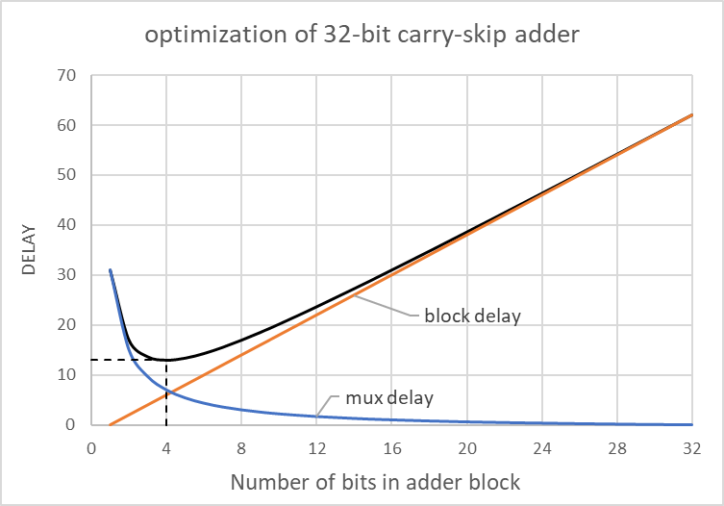
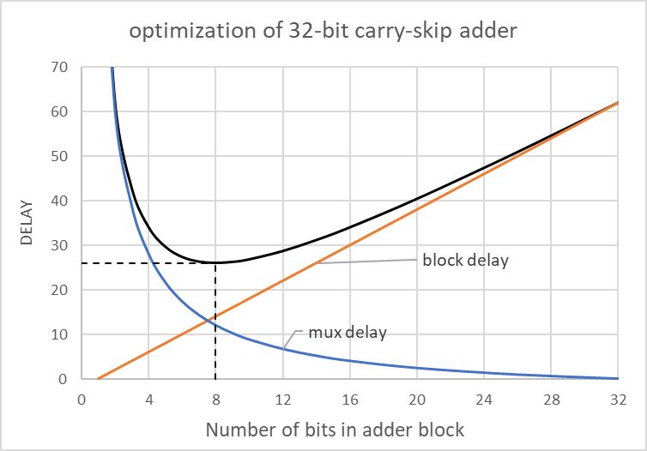
32-bit carry skip adder
Identify worst-case propagation delay for 32-bit adder!
How to optimize a 32-bit adder built with k n-bit blocks?
a_{32:25} b_{32:25}
a_{24:17} b_{24:17}
a_{16:9} b_{16:9}
a_{8:1} b_{8:1}
ADD/SUB logic
Bit P, G
ADD/SUB logic
Bit P, G
ADD/SUB logic
Bit P, G
ADD/SUB logic
Bit P, G
t_{MUX}=t_{AO}
t_{MUX}=4t_{AO}
t_{pg}
P_{32:25}
P_{24:17}
P_{16:9}
P_{8:1}
c_{out}
1
0
+
1
0
+
1
0
+
1
0
+
c_{in}
Sum_{32:25}
Sum_{24:17}
Sum_{16:9}
Sum_{8:1}
If efficient muxes with t_{MUX}=t_{AO} could be used, 4-bit blocks would be most efficient.
If muxes are slow due to their complexity, say t_{MUX}=4t_{AO}, then 8-bit blocks would be most efficient.

Slide 20
Optimization – Summary
Function to
be optimized
y
Arbitrary units
x
x_{opt}
Input variable

Slide 21
End of ”what if” lecture!
Q & A?
Notes:
In this lecture, I have given you a little teaser of what this course is all about, on how to design CMOS logic gates, and how to put cells together to build multi-bit logic arrays. We will do a lot more of this during the course.
In this introduction, focus has been on functioanlity. Later, we will go into details about performance in terms of speed and power dissipation.
Questions you might have will answered, and problems you might have encountered will be discussed during the lecture.
Thank you very much for listening!

