Slide 1
Layout templates
October 3, 2013
Kjell Jeppson

Slide 2
Prelab 3 layout templates

Slide 3
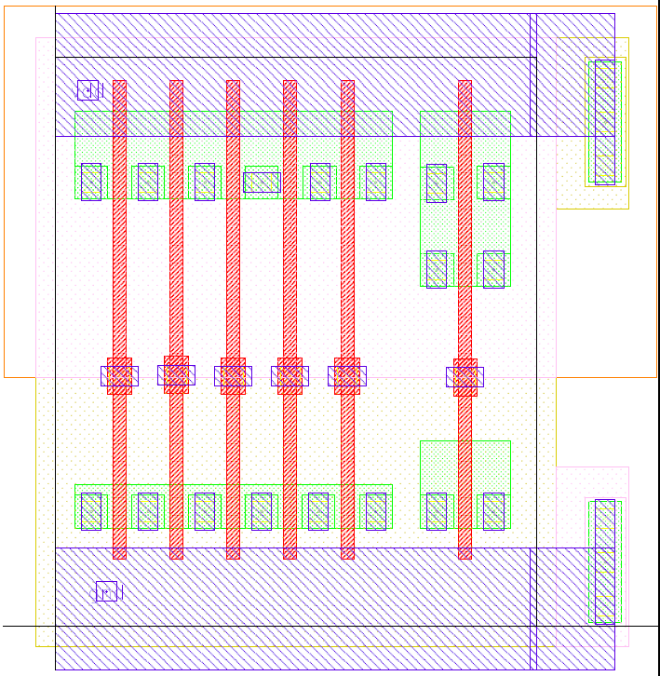
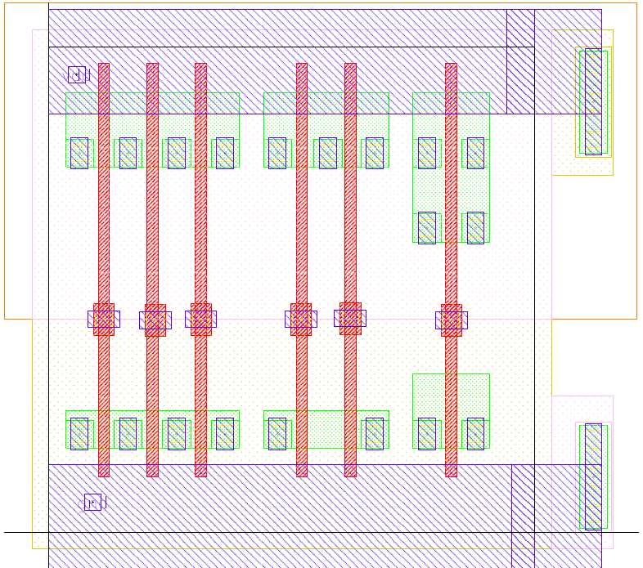
Prelab 3 layout templates

